Slide 1
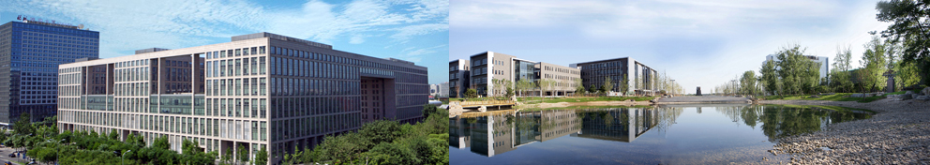
Design and Analysis of Algorithms
Part IV: Graph Algorithms
Lecture 9: Review of BFS/DFS, Topological Sort
and Strongly Connected Components
Ke Xu and Yongxin Tong
(许可 与 童咏昕)
School of CSE, Beihang University

Slide 2
Outline
Introduction to Part IV
Review of Basic Graph Search Algorithms
Basic Concepts
The Breadth-First Search (BFS) Algorithm
The Depth-First Search (DFS) Algorithm
Topological Sort
The Topological Sort Algorithm
Analysis of the Topological Sort Algorithm
Strongly Connected Components
The Algorithm of Finding SCCs
Analysis of the Algorithm

Slide 3
Outline
Introduction to Part IV
Review of Basic Graph Search Algorithms
Basic Concepts
The Breadth-First Search (BFS) Algorithm
The Depth-First Search (DFS) Algorithm
Topological Sort
The Topological Sort Algorithm
Analysis of the Topological Sort Algorithm
Strongly Connected Components
The Algorithm of Finding SCCs
Analysis of the Algorithm

Slide 4
Introduction to Part IV
In Part IV, we will illustrate several graph algorithm problems using several examples:
Basic Concepts of Graphs (图的基本概念)
Breadth-First Search [BFS] (广度优先搜索)
Depth-First Search [DFS] (深度优先搜索)
Topological Sort (拓扑排序)
Strongly Connected Components (强联通分量)
Minimum Spanning Trees (最小生成树)
Shortest Path (最短路径)
All-Pairs Shortest Paths (所有结点对的最短路径)
Maximum/Network Flows (最大流/网络流)

Slide 5
Introduction to Part IV
In Part IV, we will illustrate several graph algorithm problems using several examples:
Basic Concepts of Graphs (图的基本概念)
Breadth-First Search [BFS] (广度优先搜索)
Depth-First Search [DFS] (深度优先搜索)
Topological Sort (拓扑排序)
Strongly Connected Components (强联通分量)
Minimum Spanning Trees (最小生成树)
Shortest Path (最短路径)
All-Pairs Shortest Paths (所有结点对的最短路径)
Maximum/Network Flows (最大流/网络流)

Slide 6
Outline
Introduction to Part IV
Review of Basic Graph Search Algorithms
Basic Concepts
The Breadth-First Search (BFS) Algorithm
The Depth-First Search (DFS) Algorithm
Topological Sort
The Topological Sort Algorithm
Analysis of the Topological Sort Algorithm
Strongly Connected Components
The Algorithm of Finding SCCs
Analysis of the Algorithm

Slide 7
Graphs
Extremely useful tool in modeling problems

Slide 8
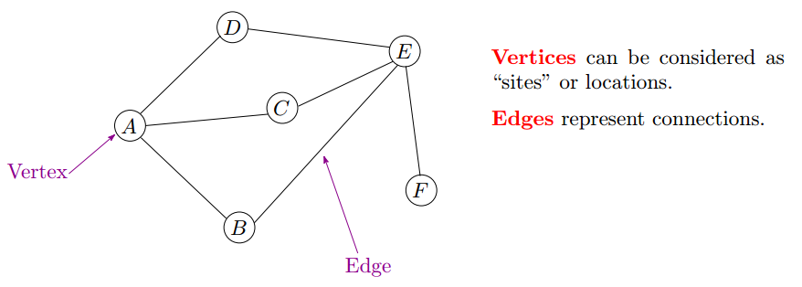
Graphs
Extremely useful tool in modeling problems
Consist of:
Vertices
Edges

Slide 9
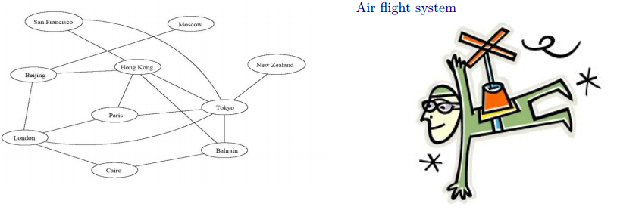
Graph Application

Slide 10
Graph Application
Each vertex represents a city

Slide 11
Graph Application
Each vertex represents a city
Each edge represents a direct flight between two cities

Slide 12
Graph Application
Each vertex represents a city
Each edge represents a direct flight between two cities
A query on direct flight = a query on whether an edge exists

Slide 13
Graph Application
Each vertex represents a city
Each edge represents a direct flight between two cities
A query on direct flight = a query on whether an edge exists
A query on how to get to a location = does a path exist from A to B

Slide 14
Graph Application
Each vertex represents a city
Each edge represents a direct flight between two cities
A query on direct flight = a query on whether an edge exists
A query on how to get to a location = does a path exist from A to B
We can even associate costs to edges (weighted graphs), then ask ‘‘what is the cheapest path from A to B’’

Slide 15
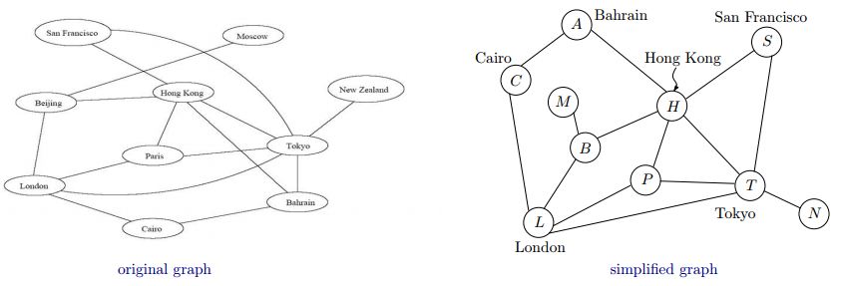
Graph Application
Each vertex represents a city
Each edge represents a direct flight between two cities
A query on direct flight = a query on whether an edge exists
A query on how to get to a location = does a path exist from A to B
We can even associate costs to edges (weighted graphs), then ask ‘‘what is the cheapest path from A to B’’

Slide 16
Why Graph Algorithms?
Graph is a pervasive data structure in computer science

Slide 17


Why Graph Algorithms?
Graph is a pervasive data structure in computer science
Networks: the Internet
Vinton G. Cerf & Robert E. Kahn
The Recipient of the Turing Award in 2004, USA.
Contributions: for pioneering work on internetworking, including the design and implementation of the Internet's basic communications protocols, TCP/IP, etc.

Slide 18

Why Graph Algorithms?
Graph is a pervasive data structure in computer science
Networks: the Internet, World Wide Web
Tim Berners-Lee
The Recipient of the Turing Award in 2016, UK.
Contributions: for inventing the World Wide Web, the first web browser, and the fundamental protocols and algorithms allowing the Web to scale.

Slide 19
Why Graph Algorithms?
Graph is a pervasive data structure in computer science
Networks: the Internet, World Wide Web, wireless networks

Slide 20
Why Graph Algorithms?
Graph is a pervasive data structure in computer science
Networks: the Internet, World Wide Web, wireless networks
Logistics: transportation, supply chain management

Slide 21
Why Graph Algorithms?
Graph is a pervasive data structure in computer science
Networks: the Internet, World Wide Web, wireless networks
Logistics: transportation, supply chain management
Relationship between objects: online dating, social networks (Facebook!)

Slide 22
Why Graph Algorithms?
Graph is a pervasive data structure in computer science
Networks: the Internet, World Wide Web, wireless networks
Logistics: transportation, supply chain management
Relationship between objects: online dating, social networks (Facebook!)
Hundreds of interesting computational problems defined on graphs

Slide 23
Why Graph Algorithms?
Graph is a pervasive data structure in computer science
Networks: the Internet, World Wide Web, wireless networks
Logistics: transportation, supply chain management
Relationship between objects: online dating, social networks (Facebook!)
Hundreds of interesting computational problems defined on graphs
We will sample a few basic ones

Slide 24
Definition
A graph G = (V, E) consists of
a set of vertices V , |V| = n, and
a set of edges E, |E| = m

Slide 25
Definition
A graph G = (V, E) consists of
a set of vertices V , |V| = n, and
a set of edges E, |E| = m
Each edge is a pair of (u, v), where u, v belongs to V

Slide 26
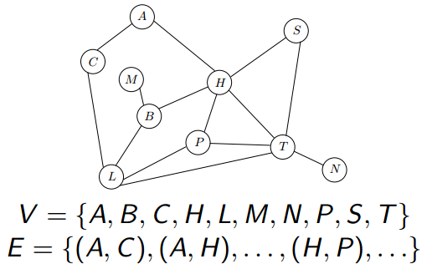
Definition
A graph G = (V, E) consists of
a set of vertices V , |V| = n, and
a set of edges E, |E| = m
Each edge is a pair of (u, v), where u, v belongs to V

Slide 27
Definition
A graph G = (V, E) consists of
a set of vertices V , |V| = n, and
a set of edges E, |E| = m
Each edge is a pair of (u, v), where u, v belongs to V

Slide 28
Definition
A graph G = (V, E) consists of
a set of vertices V , |V| = n, and
a set of edges E, |E| = m
Each edge is a pair of (u, v), where u, v belongs to V

Slide 29
Definition
A graph G = (V, E) consists of
a set of vertices V , |V| = n, and
a set of edges E, |E| = m
Each edge is a pair of (u, v), where u, v belongs to V
For directed graph, we distinguish between edge (u, v) and edge (v, u); for undirected graph, no such distinction is made.

Slide 30
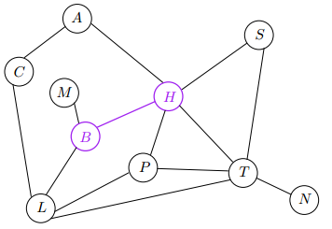
Terminology
Each edge has two endpoints

Slide 31
Terminology
Each edge has two endpoints
H and B are the endpoints of (H, B)

Slide 32
Terminology
Each edge has two endpoints
H and B are the endpoints of (H, B)
An edge joins its endpoints

Slide 33
Terminology
Each edge has two endpoints
H and B are the endpoints of (H, B)
An edge joins its endpoints
(H, B) joins H and B

Slide 34
Terminology
Each edge has two endpoints
H and B are the endpoints of (H, B)
An edge joins its endpoints
(H, B) joins H and B
Two vertices are adjacent (or neighbors) if they are joined by an edge.

Slide 35
Terminology
Each edge has two endpoints
H and B are the endpoints of (H, B)
An edge joins its endpoints
(H, B) joins H and B
Two vertices are adjacent (or neighbors) if they are joined by an edge.
H and B are adjacent

Slide 36
Terminology
Each edge has two endpoints
H and B are the endpoints of (H, B)
An edge joins its endpoints
(H, B) joins H and B
Two vertices are adjacent (or neighbors) if they are joined by an edge.
H and B are adjacent
H is a neighbor of B

Slide 37
Terminology
Each edge has two endpoints
H and B are the endpoints of (H, B)
An edge joins its endpoints
(H, B) joins H and B
Two vertices are adjacent (or neighbors) if they are joined by an edge.
H and B are adjacent
H is a neighbor of B
If vertex v is an endpoint of edge e, then the edge e is said to be incident on v. Also, the vertex v is said to be incident on e

Slide 38
Terminology
Each edge has two endpoints
H and B are the endpoints of (H, B)
An edge joins its endpoints
(H, B) joins H and B
Two vertices are adjacent (or neighbors) if they are joined by an edge.
H and B are adjacent
H is a neighbor of B
If vertex v is an endpoint of edge e, then the edge e is said to be incident on v. Also, the vertex v is said to be incident on e
(H, B) is incident on H and B

Slide 39
Terminology
Each edge has two endpoints
H and B are the endpoints of (H, B)
An edge joins its endpoints
(H, B) joins H and B
Two vertices are adjacent (or neighbors) if they are joined by an edge.
H and B are adjacent
H is a neighbor of B
If vertex v is an endpoint of edge e, then the edge e is said to be incident on v. Also, the vertex v is said to be incident on e
(H, B) is incident on H and B
H and B are incident on (H, B)

Slide 40
The Degree of a Vertex
The degree of a vertex v (degree(v)) in a graph is the number of edges incident on it.

Slide 41
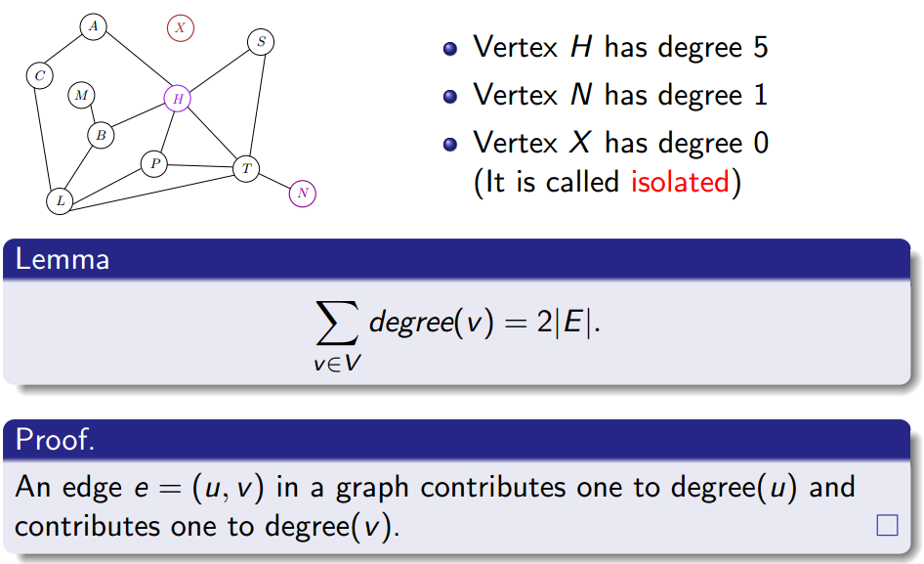
The Degree of a Vertex
The degree of a vertex v (degree(v)) in a graph is the number of edges incident on it.

Slide 42
The Degree of a Vertex
The degree of a vertex v (degree(v)) in a graph is the number of edges incident on it.

Slide 43
The Degree of a Vertex
The degree of a vertex v (degree(v)) in a graph is the number of edges incident on it.

Slide 44
The Degree of a Vertex
The degree of a vertex v (degree(v)) in a graph is the number of edges incident on it.

Slide 45
The Degree of a Vertex
The degree of a vertex v (degree(v)) in a graph is the number of edges incident on it.

Slide 46
The Degree of a Vertex
The degree of a vertex v (degree(v)) in a graph is the number of edges incident on it.

Slide 47
The Degree of a Vertex
The degree of a vertex v (degree(v)) in a graph is the number of edges incident on it.

Slide 48
Path
A path in a graph is a sequence <v₀, v₁, v₂,… , v_{k}> of vertices such that (v_{i−1}, v_{i})∈E for i = 1, 2,… ,k

Slide 49
Path
A path in a graph is a sequence <v₀, v₁, v₂,… , v_{k}> of vertices such that (v_{i−1}, v_{i})∈E for i = 1, 2,… ,k
There is a path from v₀ to v_{k}

Slide 50
Path
A path in a graph is a sequence <v₀, v₁, v₂,… , v_{k}> of vertices such that (v_{i−1}, v_{i})∈E for i = 1, 2,… ,k
There is a path from v₀ to v_{k}
Length of a path = # of edges on the path

Slide 51
Path
A path in a graph is a sequence <v₀, v₁, v₂,… , v_{k}> of vertices such that (v_{i−1}, v_{i})∈E for i = 1, 2,… ,k
There is a path from v₀ to v_{k}
Length of a path = # of edges on the path
The path contains the vertices v₀, v₁,… , v_{k} and the edges (v₀, v₁), (v₁, v₂),… , (v_{k−1}, v_{k})

Slide 52
Path
A path in a graph is a sequence <v₀, v₁, v₂,… , v_{k}> of vertices such that (v_{i−1}, v_{i})∈E for i = 1, 2,… ,k
There is a path from v₀ to v_{k}
Length of a path = # of edges on the path
The path contains the vertices v₀, v₁,… , v_{k} and the edges (v₀, v₁), (v₁, v₂),… , (v_{k−1}, v_{k})
For any 0 ≤ i ≤ j ≤ k, <v_{i}, v_{i+1},… ,v_{j}> is its subpath

Slide 53
Path
A path in a graph is a sequence <v₀, v₁, v₂,… , v_{k}> of vertices such that (v_{i−1}, v_{i})∈E for i = 1, 2,… ,k
There is a path from v₀ to v_{k}
Length of a path = # of edges on the path
The path contains the vertices v₀, v₁,… , v_{k} and the edges (v₀, v₁), (v₁, v₂),… , (v_{k−1}, v_{k})
For any 0 ≤ i ≤ j ≤ k, <v_{i}, v_{i+1},… ,v_{j}> is its subpath
If there is a path p from u to v, v is said to be reachable from u

Slide 54
Path
A path in a graph is a sequence <v₀, v₁, v₂,… , v_{k}> of vertices such that (v_{i−1}, v_{i})∈E for i = 1, 2,… ,k
There is a path from v₀ to v_{k}
Length of a path = # of edges on the path
The path contains the vertices v₀, v₁,… , v_{k} and the edges (v₀, v₁), (v₁, v₂),… , (v_{k−1}, v_{k})
For any 0 ≤ i ≤ j ≤ k, <v_{i}, v_{i+1},… ,v_{j}> is its subpath
If there is a path p from u to v, v is said to be reachable from u
A path is simple if all vertices in the path are distinct

Slide 55
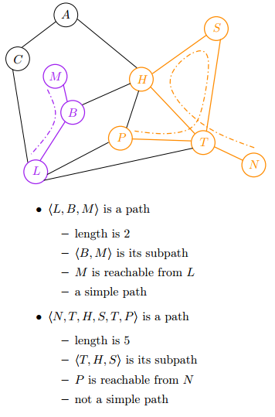
Path
A path in a graph is a sequence <v₀, v₁, v₂,… , v_{k}> of vertices such that (v_{i−1}, v_{i})∈E for i = 1, 2,… ,k
There is a path from v₀ to v_{k}
Length of a path = # of edges on the path
The path contains the vertices v₀, v₁,… , v_{k} and the edges (v₀, v₁), (v₁, v₂),… , (v_{k−1}, v_{k})
For any 0 ≤ i ≤ j ≤ k, <v_{i}, v_{i+1},… ,v_{j}> is its subpath
If there is a path p from u to v, v is said to be reachable from u
A path is simple if all vertices in the path are distinct

Slide 56
Cycle
A path <v₀, v₁, v₂,…, v_{k}> forms a cycle if v₀ = v_{k} and all edges on the path are distinct

Slide 57
Cycle
A path <v₀, v₁, v₂,…, v_{k}> forms a cycle if v₀ = v_{k} and all edges on the path are distinct
A cycle is simple if v₁, v₂,…, v_{k} are distinct

Slide 58
Cycle
A path <v₀, v₁, v₂,…, v_{k}> forms a cycle if v₀ = v_{k} and all edges on the path are distinct
A cycle is simple if v₁, v₂,…, v_{k} are distinct
A graph with no cycles is acyclic

Slide 59
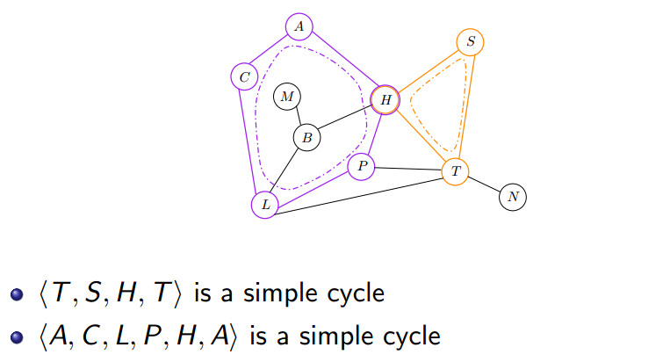
Cycle
A path <v₀, v₁, v₂,…, v_{k}> forms a cycle if v₀ = v_{k} and all edges on the path are distinct
A cycle is simple if v₁, v₂,…, v_{k} are distinct
A graph with no cycles is acyclic

Slide 60
Cycle
A path <v₀, v₁, v₂,…, v_{k}> forms a cycle if v₀ = v_{k} and all edges on the path are distinct
A cycle is simple if v₁, v₂,…, v_{k} are distinct
A graph with no cycles is acyclic

Slide 61
Cycle
A path <v₀, v₁, v₂,…, v_{k}> forms a cycle if v₀ = v_{k} and all edges on the path are distinct
A cycle is simple if v₁, v₂,…, v_{k} are distinct
A graph with no cycles is acyclic

Slide 62
Connectivity
Two vertices are connected if there is a path between them

Slide 63
Connectivity
Two vertices are connected if there is a path between them
A graph is connected if every pair of vertices is connected; otherwise, the graph is disconnected

Slide 64
Connectivity
Two vertices are connected if there is a path between them
A graph is connected if every pair of vertices is connected; otherwise, the graph is disconnected
The connected components of a graph are the equivalence classes of vertices under the "is reachable from" relation

Slide 65
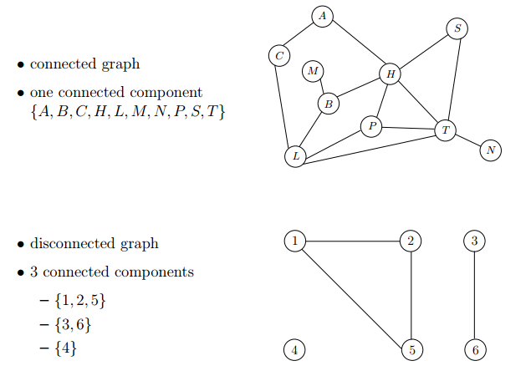
Connectivity
Two vertices are connected if there is a path between them
A graph is connected if every pair of vertices is connected; otherwise, the graph is disconnected
The connected components of a graph are the equivalence classes of vertices under the "is reachable from" relation

Slide 66
Subgraph
Graph G’ = (V’, E’) is a subgraph of G = (V, E) if V’ ⊆ V and E’ ⊆ E

Slide 67
Subgraph
Graph G’ = (V’, E’) is a subgraph of G = (V, E) if V’ ⊆ V and E’ ⊆ E
G’ is an induced subgraph of G if G’ is a subgraph of G and every edge of G connecting vertices of G’ is an edge of G’.

Slide 68
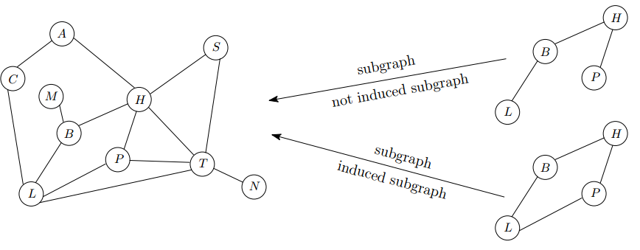
Subgraph
Graph G’ = (V’, E’) is a subgraph of G = (V, E) if V’ ⊆ V and E’ ⊆ E
G’ is an induced subgraph of G if G’ is a subgraph of G and every edge of G connecting vertices of G’ is an edge of G’.

Slide 69
Representations of Graphs: Adjacency List
V : set of vertices, E: set of edges. (As a convenience, we will sometimes use V to denote the number of vertices, and E to denote the number of edges.)
Adjacency list representation: O(V + E) storage Adj[u] — linked list of all v such that (u, v) ∈ E.

Slide 70
Representations of Graphs: Adjacency List
V : set of vertices, E: set of edges. (As a convenience, we will sometimes use V to denote the number of vertices, and E to denote the number of edges.)
Adjacency list representation: O(V + E) storage Adj[u] — linked list of all v such that (u, v) ∈ E.
Adj[0] = {1, 3, 9}; Adj[1] = {0, 9, 2}; ...

Slide 71
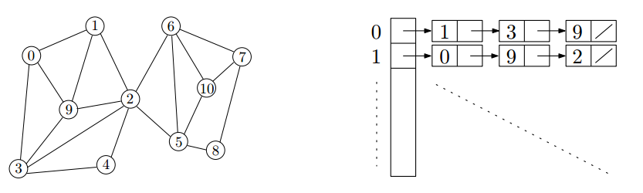
Representations of Graphs: Adjacency List
V : set of vertices, E: set of edges. (As a convenience, we will sometimes use V to denote the number of vertices, and E to denote the number of edges.)
Adjacency list representation: O(V + E) storage Adj[u] — linked list of all v such that (u, v) ∈ E.
Adj[0] = {1, 3, 9}; Adj[1] = {0, 9, 2}; ...
Can retrieve all the neighbors of u in O(degree(u)) time

Slide 72
Representations of Graphs: Adjacency Matrix
Adjacency matrix representation: O(V²) storage A = [a_{ij}], a_{ij} = 1 if (v_{i}, v_{j}) ∈ E; a_{ij} = 0 if (v_{i}, v_{j}) ∉ E. For an undirected graph, the adjacency matrix is always symmetric.

Slide 73
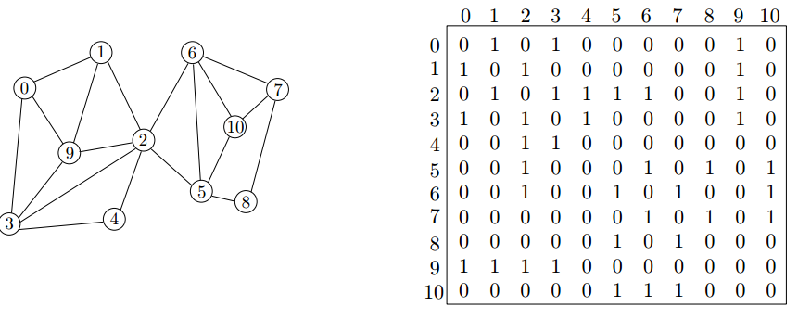
Representations of Graphs: Adjacency Matrix
Adjacency matrix representation: O(V²) storage A = [a_{ij}], a_{ij} = 1 if (v_{i}, v_{j}) ∈ E; a_{ij} = 0 if (v_{i}, v_{j}) ∉ E. For an undirected graph, the adjacency matrix is always symmetric.
Can check if u and v are connected in O(1) time.

Slide 74
Outline
Introduction to Part IV
Review of Basic Graph Search Algorithms
Basic Concepts
The Breadth-First Search (BFS) Algorithm
The Depth-First Search (DFS) Algorithm
Topological Sort
The Topological Sort Algorithm
Analysis of the Topological Sort Algorithm
Strongly Connected Components
The Algorithm of Finding SCCs
Analysis of the Algorithm

Slide 75
The Breadth-First Search (BFS) Algorithm
What does Breadth-First Search (BFS) do?

Slide 76
The Breadth-First Search (BFS) Algorithm
What does Breadth-First Search (BFS) do?
Traverse all vertices in graph, and thereby
Reveal properties of the graph

Slide 77
The Breadth-First Search (BFS) Algorithm
What does Breadth-First Search (BFS) do?
Traverse all vertices in graph, and thereby
Reveal properties of the graph
Three arrays are used to keep information gathered during traversal

Slide 78
The Breadth-First Search (BFS) Algorithm
What does Breadth-First Search (BFS) do?
Traverse all vertices in graph, and thereby
Reveal properties of the graph
Three arrays are used to keep information gathered during traversal
color[u]: the color of each vertex visited

Slide 79
The Breadth-First Search (BFS) Algorithm
What does Breadth-First Search (BFS) do?
Traverse all vertices in graph, and thereby
Reveal properties of the graph
Three arrays are used to keep information gathered during traversal
color[u]: the color of each vertex visited
WHITE: undiscovered

Slide 80
The Breadth-First Search (BFS) Algorithm
What does Breadth-First Search (BFS) do?
Traverse all vertices in graph, and thereby
Reveal properties of the graph
Three arrays are used to keep information gathered during traversal
color[u]: the color of each vertex visited
WHITE: undiscovered
GRAY: discovered but not finished processing

Slide 81
The Breadth-First Search (BFS) Algorithm
What does Breadth-First Search (BFS) do?
Traverse all vertices in graph, and thereby
Reveal properties of the graph
Three arrays are used to keep information gathered during traversal
color[u]: the color of each vertex visited
WHITE: undiscovered
GRAY: discovered but not finished processing
BLACK: finished processing

Slide 82
The Breadth-First Search (BFS) Algorithm
What does Breadth-First Search (BFS) do?
Traverse all vertices in graph, and thereby
Reveal properties of the graph
Three arrays are used to keep information gathered during traversal
color[u]: the color of each vertex visited
WHITE: undiscovered
GRAY: discovered but not finished processing
BLACK: finished processing
pred[u]: the predecessor pointer
pointing back to the vertex from which u was discovered

Slide 83
The Breadth-First Search (BFS) Algorithm
What does Breadth-First Search (BFS) do?
Traverse all vertices in graph, and thereby
Reveal properties of the graph
Three arrays are used to keep information gathered during traversal
color[u]: the color of each vertex visited
WHITE: undiscovered
GRAY: discovered but not finished processing
BLACK: finished processing
pred[u]: the predecessor pointer
pointing back to the vertex from which u was discovered
d[u]: the distance from the source to vertex u

Slide 84
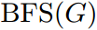
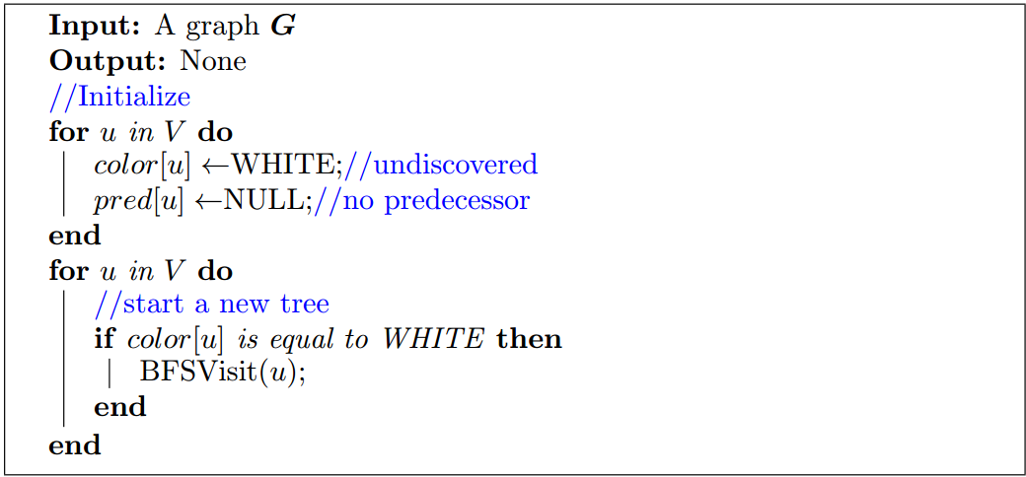
BFS Algorithm

Slide 85
BFS Algorithm

Slide 86
BFS Algorithm

Slide 87
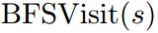
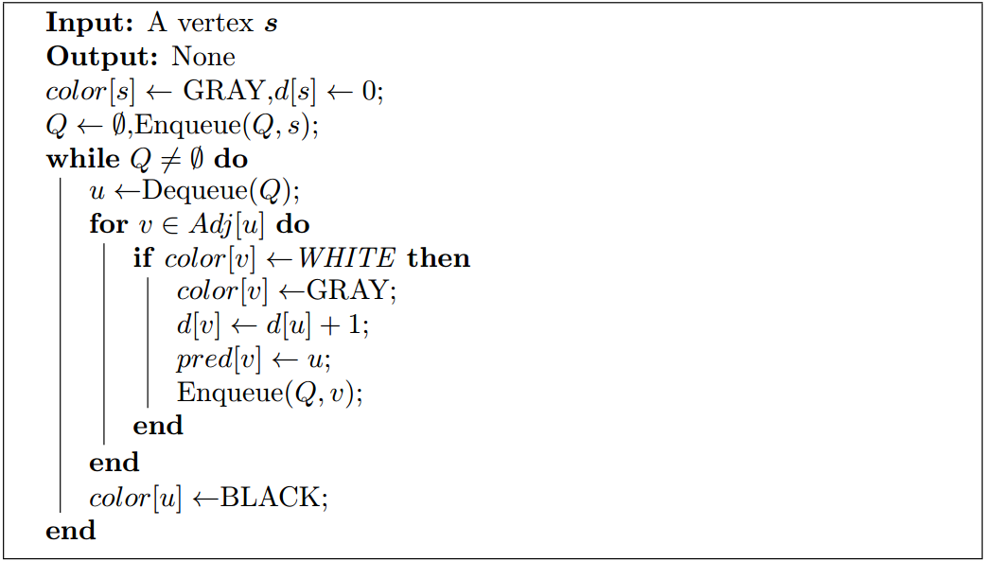
BFS Algorithm

Slide 88
BFS Algorithm

Slide 89
BFS Algorithm

Slide 90
BFS Algorithm

Slide 91
BFS Algorithm

Slide 92
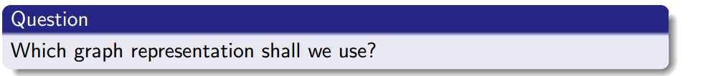
BFS Algorithm

Slide 93
BFS Example
color
pred
W
W
W
W
W
W
W
W
N
N
N
N
N
N
N
N
d
Q
∞
∞
∞
∞
∞
∞
∞
∞
1
2
3
4
5
6
7
8

Slide 94
BFS Example
color
pred
W
W
W
W
W
W
W
W
N
N
N
N
N
N
N
N
d
Q
∞
∞
∞
∞
∞
∞
∞
∞
Start from this vertex
1
2
3
4
5
6
7
8

Slide 95
BFS Example
color
pred
W
G
W
W
W
W
W
W
N
N
N
N
N
N
N
N
d
Q
∞
0
∞
∞
∞
∞
∞
∞
2
1
2
3
4
∞
0
∞
∞
∞
∞
∞
∞
5
6
7
8

Slide 96
BFS Example
color
pred
W
G
W
W
W
W
W
W
N
N
N
N
N
N
N
N
d
Q
∞
0
∞
∞
∞
∞
∞
∞
2
1
2
3
4
∞
0
∞
∞
∞
∞
∞
∞
5
6
7
8

Slide 97
BFS Example
color
pred
W
G
W
W
W
W
W
W
N
N
N
N
N
N
N
N
d
Q
∞
0
∞
∞
∞
∞
∞
∞
2
1
2
3
4
∞
0
∞
∞
∞
∞
∞
∞
5
6
7
8

Slide 98
BFS Example
color
pred
G
G
W
W
W
G
W
W
2
N
N
N
N
2
N
N
d
Q
1
0
∞
∞
∞
1
∞
∞
2
1
6
1
2
3
4
1
0
∞
∞
∞
1
∞
∞
5
6
7
8

Slide 99
BFS Example
color
pred
G
G
W
W
W
G
W
W
2
N
N
N
N
2
N
N
d
Q
1
0
∞
∞
∞
1
∞
∞
2
1
6
All adjacencies of 2 have been traversed.
1
2
3
4
1
0
∞
∞
∞
1
∞
∞
5
6
7
8

Slide 100
BFS Example
color
pred
G
B
W
W
W
G
W
W
2
N
N
N
N
2
N
N
d
Q
1
0
∞
∞
∞
1
∞
∞
2
1
6
1
2
3
4
1
0
∞
∞
∞
1
∞
∞
5
6
7
8

Slide 101
BFS Example
color
pred
G
B
W
W
W
G
W
W
2
N
N
N
N
2
N
N
d
Q
1
0
∞
∞
∞
1
∞
∞
2
1
6
1
2
3
4
1
0
∞
∞
∞
1
∞
∞
5
6
7
8

Slide 102
BFS Example
color
pred
G
B
W
W
W
G
W
W
2
N
N
N
N
2
N
N
d
Q
1
0
∞
∞
∞
1
∞
∞
2
1
6
1
2
3
4
1
0
∞
∞
∞
1
∞
∞
5
6
7
8

Slide 103
BFS Example
color
pred
G
B
W
W
G
G
W
W
2
N
N
N
1
2
N
N
d
Q
1
0
∞
∞
2
1
∞
∞
2
1
6
5
1
2
3
4
1
0
∞
∞
2
1
∞
∞
5
6
7
8

Slide 104
BFS Example
color
pred
B
B
W
W
G
G
W
W
2
N
N
N
1
2
N
N
d
Q
1
0
∞
∞
2
1
∞
∞
2
1
6
5
1
2
3
4
1
0
∞
∞
2
1
∞
∞
5
6
7
8

Slide 105
BFS Example
color
pred
B
B
W
W
G
G
W
W
2
N
N
N
1
2
N
N
d
Q
1
0
∞
∞
2
1
∞
∞
2
1
6
5
1
2
3
4
1
0
∞
∞
2
1
∞
∞
5
6
7
8

Slide 106
BFS Example
color
pred
B
B
W
W
G
G
W
W
2
N
N
N
1
2
N
N
d
Q
1
0
∞
∞
2
1
∞
∞
2
1
6
5
1
2
3
4
1
0
∞
∞
2
1
∞
∞
5
6
7
8

Slide 107
BFS Example
color
pred
B
B
G
W
G
G
G
W
2
N
6
N
1
2
6
N
d
Q
1
0
2
∞
2
1
2
∞
2
1
6
5
3
7
1
2
3
4
1
0
2
∞
2
1
2
∞
5
6
7
8

Slide 108
BFS Example
color
pred
B
B
G
W
G
B
G
W
2
N
6
N
1
2
6
N
d
Q
1
0
2
∞
2
1
2
∞
2
1
6
5
3
7
1
2
3
4
1
0
2
∞
2
1
2
∞
5
6
7
8

Slide 109
BFS Example
color
pred
B
B
G
W
G
B
G
W
2
N
6
N
1
2
6
N
d
Q
1
0
2
∞
2
1
2
∞
2
1
6
5
3
7
1
2
3
4
1
0
2
∞
2
1
2
∞
5
6
7
8

Slide 110
BFS Example
color
pred
B
B
G
W
G
B
G
W
2
N
6
N
1
2
6
N
d
Q
1
0
2
∞
2
1
2
∞
2
1
6
5
3
7
None of its adjacencies are WHITE.
1
2
3
4
1
0
2
∞
2
1
2
∞
5
6
7
8

Slide 111
BFS Example
color
pred
B
B
G
W
B
B
G
W
2
N
6
N
1
2
6
N
d
Q
1
0
2
∞
2
1
2
∞
2
1
6
5
3
7
1
2
3
4
1
0
2
∞
2
1
2
∞
5
6
7
8

Slide 112
BFS Example
color
pred
B
B
G
W
B
B
G
W
2
N
6
N
1
2
6
N
d
Q
1
0
2
∞
2
1
2
∞
2
1
6
5
3
7
1
2
3
4
1
0
2
∞
2
1
2
∞
5
6
7
8

Slide 113
BFS Example
color
pred
B
B
G
W
B
B
G
W
2
N
6
N
1
2
6
N
d
Q
1
0
2
∞
2
1
2
∞
2
1
6
5
3
7
1
2
3
4
1
0
2
∞
2
1
2
∞
5
6
7
8

Slide 114
BFS Example
color
pred
B
B
G
G
B
B
G
W
2
N
6
3
1
2
6
N
d
Q
1
0
2
3
2
1
2
∞
2
1
6
5
3
7
4
1
2
3
4
1
0
2
3
2
1
2
∞
5
6
7
8

Slide 115
BFS Example
color
pred
B
B
B
G
B
B
G
W
2
N
6
3
1
2
6
N
d
Q
1
0
2
3
2
1
2
∞
2
1
6
5
3
7
4
1
2
3
4
1
0
2
3
2
1
2
∞
5
6
7
8

Slide 116
BFS Example
color
pred
B
B
B
G
B
B
G
W
2
N
6
3
1
2
6
N
d
Q
1
0
2
3
2
1
2
∞
2
1
6
5
3
7
4
1
2
3
4
1
0
2
3
2
1
2
∞
5
6
7
8

Slide 117
BFS Example
color
pred
B
B
B
G
B
B
G
W
2
N
6
3
1
2
6
N
d
Q
1
0
2
3
2
1
2
∞
2
1
6
5
3
7
4
1
2
3
4
1
0
2
3
2
1
2
∞
5
6
7
8

Slide 118
BFS Example
color
pred
B
B
B
G
B
B
G
G
2
N
6
3
1
2
6
7
d
Q
1
0
2
3
2
1
2
3
2
1
6
5
3
7
4
8
1
2
3
4
1
0
2
3
2
1
2
3
5
6
7
8

Slide 119
BFS Example
color
pred
B
B
B
G
B
B
B
G
2
N
6
3
1
2
6
7
d
Q
1
0
2
3
2
1
2
3
2
1
6
5
3
7
4
8
1
2
3
4
1
0
2
3
2
1
2
3
5
6
7
8

Slide 120
BFS Example
color
pred
B
B
B
G
B
B
B
G
2
N
6
3
1
2
6
7
d
Q
1
0
2
3
2
1
2
3
2
1
6
5
3
7
4
8
1
2
3
4
1
0
2
3
2
1
2
3
5
6
7
8

Slide 121
BFS Example
color
pred
B
B
B
B
B
B
B
G
2
N
6
3
1
2
6
7
d
Q
1
0
2
3
2
1
2
3
2
1
6
5
3
7
4
8
1
2
3
4
1
0
2
3
2
1
2
3
5
6
7
8

Slide 122
BFS Example
color
pred
B
B
B
B
B
B
B
G
2
N
6
3
1
2
6
7
d
Q
1
0
2
3
2
1
2
3
2
1
6
5
3
7
4
8
1
2
3
4
1
0
2
3
2
1
2
3
5
6
7
8

Slide 123
BFS Example
color
pred
B
B
B
B
B
B
B
B
2
N
6
3
1
2
6
7
d
Q
1
0
2
3
2
1
2
3
2
1
6
5
3
7
4
8
1
2
3
4
1
0
2
3
2
1
2
3
5
6
7
8

Slide 124
BFS Example
color
pred
B
B
B
B
B
B
B
B
2
N
6
3
1
2
6
7
d
Q
1
0
2
3
2
1
2
3
2
1
6
5
3
7
4
8
1
2
3
4
1
0
2
3
2
1
2
3
5
6
7
8

Slide 125
Running Time of BFS
On each vertex u, we spend time T_{u} = O(1+degree(u))
The total running time is
$$\sum_{uεV}{T_{u}}≤\sum_{uεV}{\left(O\left(1+degree\left(u\right)\right)\right)}=O\left(V+E\right)$$

Slide 126
Running Time of BFS
On each vertex u, we spend time T_{u} = O(1+degree(u))
The total running time is
$$\sum_{uεV}{T_{u}}≤\sum_{uεV}{\left(O\left(1+degree\left(u\right)\right)\right)}=O\left(V+E\right)$$

Slide 127
Running Time of BFS
On each vertex u, we spend time T_{u} = O(1+degree(u))
The total running time is
$$\sum_{uεV}{T_{u}}≤\sum_{uεV}{\left(O\left(1+degree\left(u\right)\right)\right)}=O\left(V+E\right)$$
Hence, the running of BFS on a graph with V vertices and E edges is O(V + E)

Slide 128
Running Time of BFS
On each vertex u, we spend time T_{u} = O(1+degree(u))
The total running time is
$$\sum_{uεV}{T_{u}}≤\sum_{uεV}{\left(O\left(1+degree\left(u\right)\right)\right)}=O\left(V+E\right)$$
Hence, the running of BFS on a graph with V vertices and E edges is O(V + E)
Applications:
Shortest paths in a graph
What if the graph is weighted?
Finding connected components

Slide 129

回顾：“啤酒-尿布”与数据挖掘
Rakesh Agrawal
由于在数据挖掘领域中的先驱性研究，特别是关于关联规则挖掘与隐私保护的研究，其被称为数据挖掘之父。
其关于关联规则挖掘的论文，至今已经被全球学者引用超过4.4万次，并分别获得数据库领域国际顶级会议SIGMOD和VLDB的“时间检验奖”与“最具影响力奖”。
Rakesh Agrawal
Rakesh Agrawal, Tomasz Imielinski, Arun N. Swami. Mining Association Rules between Sets of Items in Large Databases.
In SIGMOD, Pages 207-216, 1993 . (CCF A类会议)

Slide 130







An Application of BFS: Apriori Algorithm
Supermarket Application
Item
History or Transaction
Raymond
apple
coke
coffee
David
…
We want to find some associations between items.
diaper
coke
An interesting association:
Diaper and Beer are usually bought together.
Emily
…
milk
biscuit
Why? Is it strange?
Derek
…
coke
milk
diaper
beer

Slide 131
An Application of BFS: Apriori Algorithm
Supermarket Application
An interesting association:
Diaper and Beer are usually bought together.
Why? Is it strange?
diaper
beer

Slide 132
An Application of BFS: Apriori Algorithm
Supermarket Application
Why? Is it strange?
An interesting association:
Diaper and Beer are usually bought together.
diaper
beer
Reasons:
This pattern occurs frequently in the early evening.
Daytime
Office
Working…

Slide 133
An Application of BFS: Apriori Algorithm
Supermarket Application
Why? Is it strange?
An interesting association:
Diaper and Beer are usually bought together.
diaper
beer
Reasons:
This pattern occurs frequently in the early evening.
Early Evening
Morning
Office
Home
Please buy diapers

Slide 134

An Application of BFS: Apriori Algorithm
A Specific Threshold=2
Itemset | sup
{A} | 2
{B} | 3
{C} | 3
{D} | 1
{E} | 3
Database TDB
Itemset | sup
{A} | 2
{B} | 3
{C} | 3
{E} | 3
L₁
Tid | Items
10 | A, C, D
20 | B, C, E
30 | A, B, C, E
40 | B, E
C₁
Dr. R. Agrawal
1st scan
C₂
Itemset | sup
{A, B} | 1
{A, C} | 2
{A, E} | 1
{B, C} | 2
{B, E} | 3
{C, E} | 2
C₂
Itemset
{A, B}
{A, C}
{A, E}
{B, C}
{B, E}
{C, E}
L₂
Itemset | sup
{A, C} | 2
{B, C} | 2
{B, E} | 3
{C, E} | 2
2nd scan
C₃
Itemset
{B, C, E}
3rd scan
L₃
Itemset | sup
{B, C, E} | 2

Slide 135
Outline
Introduction to Part IV
Review of Basic Graph Search Algorithms
Basic Concepts
The Breadth-First Search (BFS) Algorithm
The Depth-First Search (DFS) Algorithm
Topological Sort
The Topological Sort Algorithm
Analysis of the Topological Sort Algorithm
Strongly Connected Components
The Algorithm of Finding SCCs
Analysis of the Algorithm

Slide 136
The Depth-First Search (DFS) Algorithm
What does Depth-First Search (DFS) do?

Slide 137
The Depth-First Search (DFS) Algorithm
What does Depth-First Search (DFS) do?
Traverse all vertices in graph, and thereby
Reveal properties of the graph.

Slide 138
The Depth-First Search (DFS) Algorithm
What does Depth-First Search (DFS) do?
Traverse all vertices in graph, and thereby
Reveal properties of the graph.
Four arrays are used to keep information gathered during traversal

Slide 139
The Depth-First Search (DFS) Algorithm
What does Depth-First Search (DFS) do?
Traverse all vertices in graph, and thereby
Reveal properties of the graph.
Four arrays are used to keep information gathered during traversal
color[u]: the color of each vertex visited

Slide 140
The Depth-First Search (DFS) Algorithm
What does Depth-First Search (DFS) do?
Traverse all vertices in graph, and thereby
Reveal properties of the graph.
Four arrays are used to keep information gathered during traversal
color[u]: the color of each vertex visited
WHITE: undiscovered

Slide 141
The Depth-First Search (DFS) Algorithm
What does Depth-First Search (DFS) do?
Traverse all vertices in graph, and thereby
Reveal properties of the graph.
Four arrays are used to keep information gathered during traversal
color[u]: the color of each vertex visited
WHITE: undiscovered
GRAY: discovered but not finished processing

Slide 142
The Depth-First Search (DFS) Algorithm
What does Depth-First Search (DFS) do?
Traverse all vertices in graph, and thereby
Reveal properties of the graph.
Four arrays are used to keep information gathered during traversal
color[u]: the color of each vertex visited
WHITE: undiscovered
GRAY: discovered but not finished processing
BLACK: finished processing

Slide 143
The Depth-First Search (DFS) Algorithm
What does Depth-First Search (DFS) do?
Traverse all vertices in graph, and thereby
Reveal properties of the graph.
Four arrays are used to keep information gathered during traversal
color[u]: the color of each vertex visited
WHITE: undiscovered
GRAY: discovered but not finished processing
BLACK: finished processing
pred[u]: the predecessor pointer
pointing back to the vertex from which u was discovered

Slide 144
The Depth-First Search (DFS) Algorithm
What does Depth-First Search (DFS) do?
Traverse all vertices in graph, and thereby
Reveal properties of the graph.
Four arrays are used to keep information gathered during traversal
color[u]: the color of each vertex visited
WHITE: undiscovered
GRAY: discovered but not finished processing
BLACK: finished processing
pred[u]: the predecessor pointer
pointing back to the vertex from which u was discovered
d[u]: the discovery time
a counter indicating when vertex u is discovered

Slide 145
The Depth-First Search (DFS) Algorithm
What does Depth-First Search (DFS) do?
Traverse all vertices in graph, and thereby
Reveal properties of the graph.
Four arrays are used to keep information gathered during traversal
color[u]: the color of each vertex visited
WHITE: undiscovered
GRAY: discovered but not finished processing
BLACK: finished processing
pred[u]: the predecessor pointer
pointing back to the vertex from which u was discovered
d[u]: the discovery time
a counter indicating when vertex u is discovered
f[u]: the finishing time
a counter indicating when the processing of vertex u (and all its descendants) is finished

Slide 146
The DFS Algorithm
How does DFS work?

Slide 147
The DFS Algorithm
How does DFS work?
It starts from an initial vertex
After visiting a vertex, it recursively visits all of its neighbors
The strategy is to search "deeper" in the graph whenever possible

Slide 148
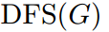
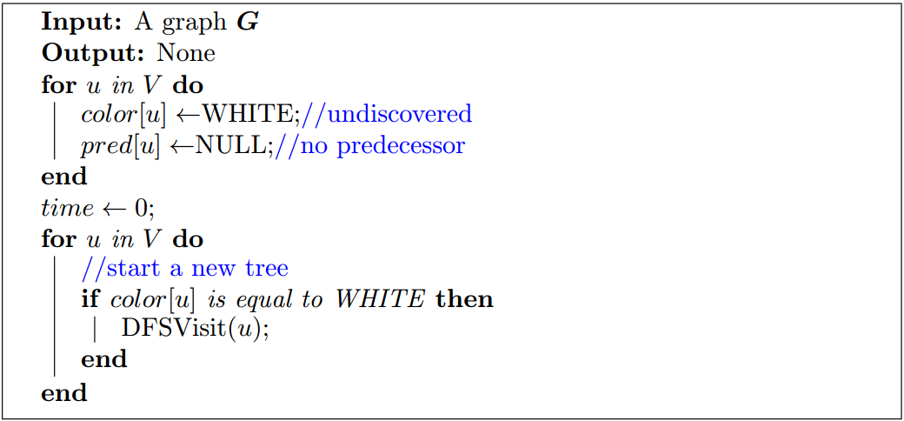
DFS Algorithm

Slide 149
DFS Algorithm

Slide 150
DFS Algorithm

Slide 151
DFS Algorithm

Slide 152
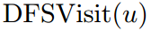
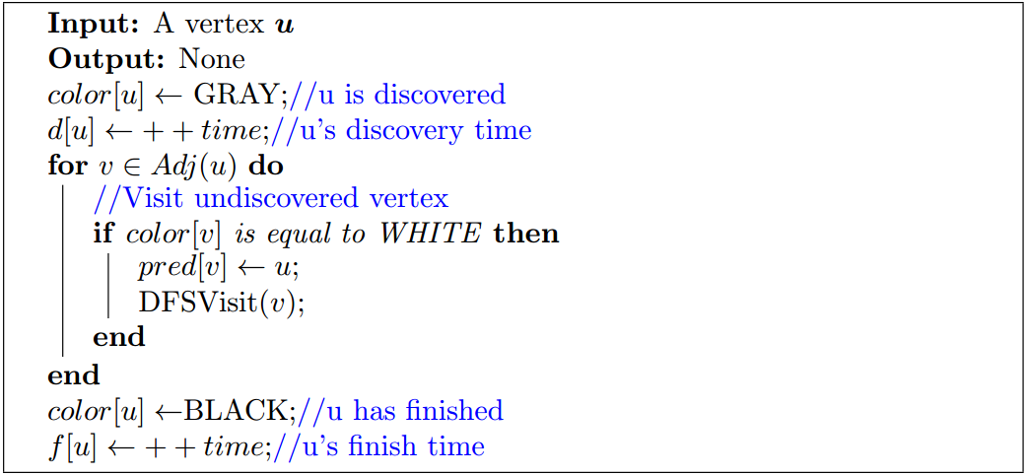
DFS Algorithm

Slide 153
DFS Algorithm

Slide 154
DFS Algorithm

Slide 155
DFS Algorithm

Slide 156
DFS Algorithm

Slide 157
DFS Algorithm

Slide 158
DFS Algorithm

Slide 159
DFS Algorithm

Slide 160
DFS Example
time = 0
color
pred
W
W
W
W
W
W
W
W
N
N
N
N
N
N
N
N
d
f
∞
∞
∞
∞
∞
∞
∞
∞
∞
∞
∞
∞
∞
∞
∞
∞
1
2
3
4
5
6
7
8

Slide 161
DFS Example
time = 0
color
pred
W
W
W
W
W
W
W
W
N
N
N
N
N
N
N
N
d
f
∞
∞
∞
∞
∞
∞
∞
∞
∞
∞
∞
∞
∞
∞
∞
∞
1
2
3
4
Start from this vertex
5
6
7
8

Slide 162
DFS Example
time = 1
color
pred
W
G
W
W
W
W
W
W
N
N
N
N
N
N
N
N
d
f
∞
1
∞
∞
∞
∞
∞
∞
∞
∞
∞
∞
∞
∞
∞
∞
1
2
3
4
1/X
5
6
7
8

Slide 163
DFS Example
time = 1
color
pred
W
G
W
W
W
W
W
W
N
N
N
N
N
N
N
N
d
f
∞
1
∞
∞
∞
∞
∞
∞
∞
∞
∞
∞
∞
∞
∞
∞
1
2
3
4
1/X
5
6
7
8

Slide 164
DFS Example
time = 2
color
pred
W
G
W
W
W
W
W
W
N
N
N
N
N
N
N
N
d
f
∞
1
∞
∞
∞
∞
∞
∞
∞
∞
∞
∞
∞
∞
∞
∞
1
2
3
4
1/X
5
6
7
8

Slide 165
DFS Example
time = 2
color
pred
G
G
W
W
W
W
W
W
2
N
N
N
N
N
N
N
d
f
2
1
∞
∞
∞
∞
∞
∞
∞
∞
∞
∞
∞
∞
∞
∞
1
2
3
4
2/X
1/X
5
6
7
8

Slide 166
DFS Example
time = 2
color
pred
G
G
W
W
W
W
W
W
2
N
N
N
N
N
N
N
d
f
2
1
∞
∞
∞
∞
∞
∞
∞
∞
∞
∞
∞
∞
∞
∞
1
2
3
4
2/X
1/X
5
6
7
8

Slide 167
DFS Example
time = 3
color
pred
G
G
W
W
W
W
W
W
2
N
N
N
N
N
N
N
d
f
2
1
∞
∞
∞
∞
∞
∞
∞
∞
∞
∞
∞
∞
∞
∞
1
2
3
4
2/X
1/X
5
6
7
8

Slide 168
DFS Example
time = 3
color
pred
G
G
W
W
G
W
W
W
2
N
N
N
1
N
N
N
d
f
2
1
∞
∞
3
∞
∞
∞
∞
∞
∞
∞
∞
∞
∞
∞
1
2
3
4
2/X
1/X
3/X
5
6
7
8

Slide 169
DFS Example
time = 3
color
pred
G
G
W
W
G
W
W
W
2
N
N
N
1
N
N
N
d
f
2
1
∞
∞
3
∞
∞
∞
∞
∞
∞
∞
∞
∞
∞
∞
1
2
3
4
2/X
1/X
3/X
None of its adjacencies is WHITE.
5
6
7
8

Slide 170
DFS Example
time = 4
color
pred
G
G
W
W
G
W
W
W
2
N
N
N
1
N
N
N
d
f
2
1
∞
∞
3
∞
∞
∞
∞
∞
∞
∞
∞
∞
∞
∞
1
2
3
4
2/X
1/X
3/X
5
6
7
8

Slide 171
DFS Example
time = 4
color
pred
G
G
W
W
B
W
W
W
2
N
N
N
1
N
N
N
d
f
2
1
∞
∞
3
∞
∞
∞
∞
∞
∞
∞
4
∞
∞
∞
1
2
3
4
2/X
1/X
3/4
5
6
7
8

Slide 172
DFS Example
time = 4
color
pred
G
G
W
W
B
W
W
W
2
N
N
N
1
N
N
N
d
f
2
1
∞
∞
3
∞
∞
∞
∞
∞
∞
∞
4
∞
∞
∞
1
2
3
4
2/X
1/X
3/4
5
6
7
8

Slide 173
DFS Example
time = 4
color
pred
G
G
W
W
B
W
W
W
2
N
N
N
1
N
N
N
d
f
2
1
∞
∞
3
∞
∞
∞
∞
∞
∞
∞
4
∞
∞
∞
1
2
3
4
2/X
1/X
All of its WHITE adjacencies are traversed.
3/4
5
6
7
8

Slide 174
DFS Example
time = 5
color
pred
G
G
W
W
B
W
W
W
2
N
N
N
1
N
N
N
d
f
2
1
∞
∞
3
∞
∞
∞
∞
∞
∞
∞
4
∞
∞
∞
1
2
3
4
2/X
1/X
3/4
5
6
7
8

Slide 175
DFS Example
time = 5
color
pred
B
G
W
W
B
W
W
W
2
N
N
N
1
N
N
N
d
f
2
1
∞
∞
3
∞
∞
∞
5
∞
∞
∞
4
∞
∞
∞
1
2
3
4
2/5
1/X
3/4
5
6
7
8

Slide 176
DFS Example
time = 5
color
pred
B
G
W
W
B
W
W
W
2
N
N
N
1
N
N
N
d
f
2
1
∞
∞
3
∞
∞
∞
5
∞
∞
∞
4
∞
∞
∞
1
2
3
4
2/5
1/X
3/4
5
6
7
8

Slide 177
DFS Example
time = 6
color
pred
B
G
W
W
B
W
W
W
2
N
N
N
1
N
N
N
d
f
2
1
∞
∞
3
∞
∞
∞
5
∞
∞
∞
4
∞
∞
∞
1
2
3
4
2/5
1/X
3/4
5
6
7
8

Slide 178
DFS Example
time = 6
color
pred
B
G
W
W
B
G
W
W
2
N
N
N
1
2
N
N
d
f
2
1
∞
∞
3
6
∞
∞
5
∞
∞
∞
4
∞
∞
∞
1
2
3
4
2/5
1/X
3/4
6/X
5
6
7
8

Slide 179
DFS Example
time = 6
color
pred
B
G
W
W
B
G
W
W
2
N
N
N
1
2
N
N
d
f
2
1
∞
∞
3
6
∞
∞
5
∞
∞
∞
4
∞
∞
∞
1
2
3
4
2/5
1/X
3/4
6/X
5
6
7
8

Slide 180
DFS Example
time = 7
color
pred
B
G
W
W
B
G
W
W
2
N
N
N
1
2
N
N
d
f
2
1
∞
∞
3
6
∞
∞
5
∞
∞
∞
4
∞
∞
∞
1
2
3
4
2/5
1/X
3/4
6/X
5
6
7
8

Slide 181
DFS Example
time = 7
color
pred
B
G
G
W
B
G
W
W
2
N
6
N
1
2
N
N
d
f
2
1
7
∞
3
6
∞
∞
5
∞
∞
∞
4
∞
∞
∞
1
2
3
4
2/5
1/X
7/X
3/4
6/X
5
6
7
8

Slide 182
DFS Example
time = 7
color
pred
B
G
G
W
B
G
W
W
2
N
6
N
1
2
N
N
d
f
2
1
7
∞
3
6
∞
∞
5
∞
∞
∞
4
∞
∞
∞
1
2
3
4
2/5
1/X
7/X
3/4
6/X
5
6
7
8

Slide 183
DFS Example
time = 8
color
pred
B
G
G
W
B
G
W
W
2
N
6
N
1
2
N
N
d
f
2
1
7
∞
3
6
∞
∞
5
∞
∞
∞
4
∞
∞
∞
1
2
3
4
2/5
1/X
7/X
3/4
6/X
5
6
7
8

Slide 184
DFS Example
time = 8
color
pred
B
G
G
G
B
G
W
W
2
N
6
3
1
2
N
N
d
f
2
1
7
8
3
6
∞
∞
5
∞
∞
∞
4
∞
∞
∞
1
2
3
4
2/5
1/X
7/X
8/X
3/4
6/X
5
6
7
8

Slide 185
DFS Example
time = 8
color
pred
B
G
G
G
B
G
W
W
2
N
6
3
1
2
N
N
d
f
2
1
7
8
3
6
∞
∞
5
∞
∞
∞
4
∞
∞
∞
1
2
3
4
2/5
1/X
7/X
8/X
3/4
6/X
5
6
7
8

Slide 186
DFS Example
time = 9
color
pred
B
G
G
G
B
G
W
W
2
N
6
3
1
2
N
N
d
f
2
1
7
8
3
6
∞
∞
5
∞
∞
∞
4
∞
∞
∞
1
2
3
4
2/5
1/X
7/X
8/X
3/4
6/X
5
6
7
8

Slide 187
DFS Example
time = 9
color
pred
B
G
G
G
B
G
W
G
2
N
6
3
1
2
N
4
d
f
2
1
7
8
3
6
∞
9
5
∞
∞
∞
4
∞
∞
∞
1
2
3
4
2/5
1/X
7/X
8/X
3/4
6/X
9/X
5
6
7
8

Slide 188
DFS Example
time = 9
color
pred
B
G
G
G
B
G
W
G
2
N
6
3
1
2
N
4
d
f
2
1
7
8
3
6
∞
9
5
∞
∞
∞
4
∞
∞
∞
1
2
3
4
2/5
1/X
7/X
8/X
3/4
6/X
9/X
5
6
7
8

Slide 189
DFS Example
time = 10
color
pred
B
G
G
G
B
G
W
G
2
N
6
3
1
2
N
4
d
f
2
1
7
8
3
6
∞
9
5
∞
∞
∞
4
∞
∞
∞
1
2
3
4
2/5
1/X
7/X
8/X
3/4
6/X
9/X
5
6
7
8

Slide 190
DFS Example
time = 10
color
pred
B
G
G
G
B
G
G
G
2
N
6
3
1
2
8
4
d
f
2
1
7
8
3
6
10
9
5
∞
∞
∞
4
∞
∞
∞
1
2
3
4
2/5
1/X
7/X
8/X
3/4
6/X
10/X
9/X
5
6
7
8

Slide 191
DFS Example
time = 10
color
pred
B
G
G
G
B
G
G
G
2
N
6
3
1
2
8
4
d
f
2
1
7
8
3
6
10
9
5
∞
∞
∞
4
∞
∞
∞
1
2
3
4
2/5
1/X
7/X
8/X
None of its adjacencies is WHITE.
3/4
6/X
10/X
9/X
5
6
7
8

Slide 192
DFS Example
time = 11
color
pred
B
G
G
G
B
G
G
G
2
N
6
3
1
2
8
4
d
f
2
1
7
8
3
6
10
9
5
∞
∞
∞
4
∞
∞
∞
1
2
3
4
2/5
1/X
7/X
8/X
3/4
6/X
10/X
9/X
5
6
7
8

Slide 193
DFS Example
time = 11
color
pred
B
G
G
G
B
G
B
G
2
N
6
3
1
2
8
4
d
f
2
1
7
8
3
6
10
9
5
∞
∞
∞
4
∞
11
∞
1
2
3
4
2/5
1/X
7/X
8/X
3/4
6/X
10/11
9/X
5
6
7
8

Slide 194
DFS Example
time = 11
color
pred
B
G
G
G
B
G
B
G
2
N
6
3
1
2
8
4
d
f
2
1
7
8
3
6
10
9
5
∞
∞
∞
4
∞
11
∞
1
2
3
4
2/5
1/X
7/X
8/X
3/4
6/X
10/11
9/X
5
6
7
8

Slide 195
DFS Example
time = 12
color
pred
B
G
G
G
B
G
B
B
2
N
6
3
1
2
8
4
d
f
2
1
7
8
3
6
10
9
5
∞
∞
∞
4
∞
11
12
1
2
3
4
2/5
1/X
7/X
8/X
3/4
6/X
10/11
9/12
5
6
7
8

Slide 196
DFS Example
time = 12
color
pred
B
G
G
G
B
G
B
B
2
N
6
3
1
2
8
4
d
f
2
1
7
8
3
6
10
9
5
∞
∞
∞
4
∞
11
12
1
2
3
4
2/5
1/X
7/X
8/X
3/4
6/X
10/11
9/12
5
6
7
8

Slide 197
DFS Example
time = 13
color
pred
B
G
G
B
B
G
B
B
2
N
6
3
1
2
8
4
d
f
2
1
7
8
3
6
10
9
5
∞
∞
13
4
∞
11
12
1
2
3
4
2/5
1/X
7/X
8/13
3/4
6/X
10/11
9/12
5
6
7
8

Slide 198
DFS Example
time = 13
color
pred
B
G
G
B
B
G
B
B
2
N
6
3
1
2
8
4
d
f
2
1
7
8
3
6
10
9
5
∞
∞
13
4
∞
11
12
1
2
3
4
2/5
1/X
7/X
8/13
3/4
6/X
10/11
9/12
5
6
7
8

Slide 199
DFS Example
time = 14
color
pred
B
G
B
B
B
G
B
B
2
N
6
3
1
2
8
4
d
f
2
1
7
8
3
6
10
9
5
∞
14
13
4
∞
11
12
1
2
3
4
2/5
1/X
7/14
8/13
3/4
6/X
10/11
9/12
5
6
7
8

Slide 200
DFS Example
time = 14
color
pred
B
G
B
B
B
G
B
B
2
N
6
3
1
2
8
4
d
f
2
1
7
8
3
6
10
9
5
∞
14
13
4
∞
11
12
1
2
3
4
2/5
1/X
7/14
8/13
3/4
6/X
10/11
9/12
5
6
7
8

Slide 201
DFS Example
time = 15
color
pred
B
G
B
B
B
B
B
B
2
N
6
3
1
2
8
4
d
f
2
1
7
8
3
6
10
9
5
∞
14
13
4
15
11
12
1
2
3
4
2/5
1/X
7/14
8/13
3/4
6/15
10/11
9/12
5
6
7
8

Slide 202
DFS Example
time = 15
color
pred
B
G
B
B
B
B
B
B
2
N
6
3
1
2
8
4
d
f
2
1
7
8
3
6
10
9
5
∞
14
13
4
15
11
12
1
2
3
4
2/5
1/X
7/14
8/13
3/4
6/15
10/11
9/12
5
6
7
8

Slide 203
DFS Example
time = 16
color
pred
B
B
B
B
B
B
B
B
2
N
6
3
1
2
8
4
d
f
2
1
7
8
3
6
10
9
5
16
14
13
4
15
11
12
1
2
3
4
2/5
1/16
7/14
8/13
3/4
6/15
10/11
9/12
5
6
7
8

Slide 204
DFS Example
time = 16
color
pred
B
B
B
B
B
B
B
B
2
N
6
3
1
2
8
4
d
f
2
1
7
8
3
6
10
9
5
16
14
13
4
15
11
12
1
2
3
4
2/5
1/16
7/14
8/13
3/4
6/15
10/11
9/12
5
6
7
8

Slide 205
Running Time of DFS
The procedure DFSVisit is called exactly once for each vertex u ∈ V

Slide 206
Running Time of DFS
The procedure DFSVisit is called exactly once for each vertex u ∈ V
since DFSVisit is invoked only on white vertices and the first thing it does is paint the vertex gray

Slide 207
Running Time of DFS
The procedure DFSVisit is called exactly once for each vertex u ∈ V
since DFSVisit is invoked only on white vertices and the first thing it does is paint the vertex gray
During an execution of DFSVisit(u), the for loop is executed |Adj(u)| = degree(u) times

Slide 208
Running Time of DFS
The procedure DFSVisit is called exactly once for each vertex u ∈ V
since DFSVisit is invoked only on white vertices and the first thing it does is paint the vertex gray
During an execution of DFSVisit(u), the for loop is executed |Adj(u)| = degree(u) times
On each vertex u, we spend time T_{u} = O(1 + degree(u))

Slide 209
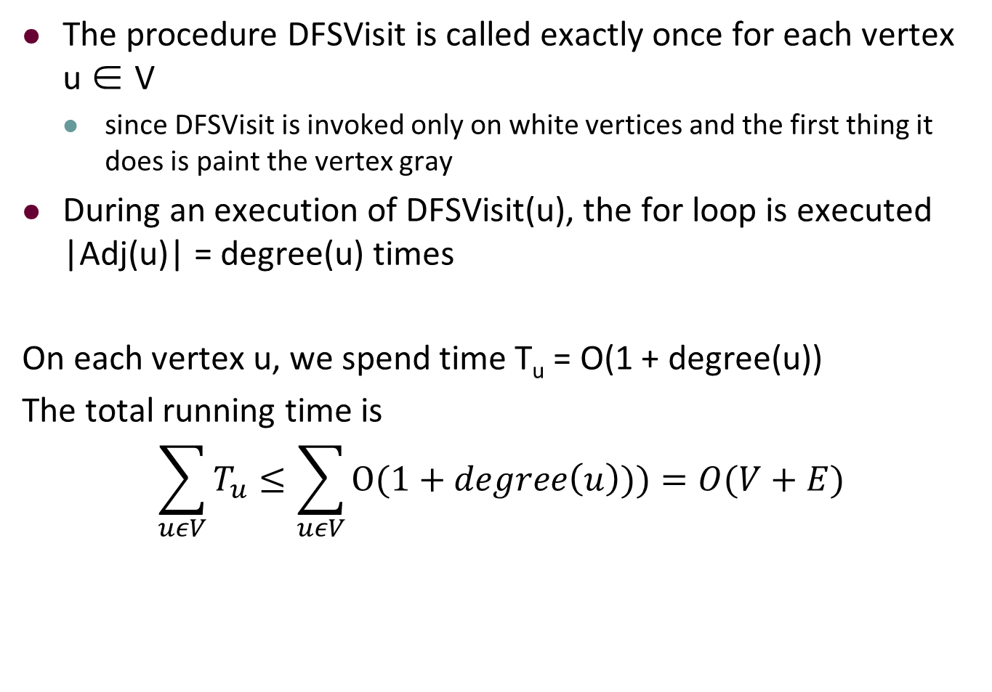
Running Time of DFS
The procedure DFSVisit is called exactly once for each vertex u ∈ V
since DFSVisit is invoked only on white vertices and the first thing it does is paint the vertex gray
During an execution of DFSVisit(u), the for loop is executed |Adj(u)| = degree(u) times
On each vertex u, we spend time T_{u} = O(1 + degree(u))
The total running time is
$$\sum_{uεV}{T_{u}≤\sum_{uεV}{O(1+degree\left(u\right)))=O(V+E)}}$$

Slide 210
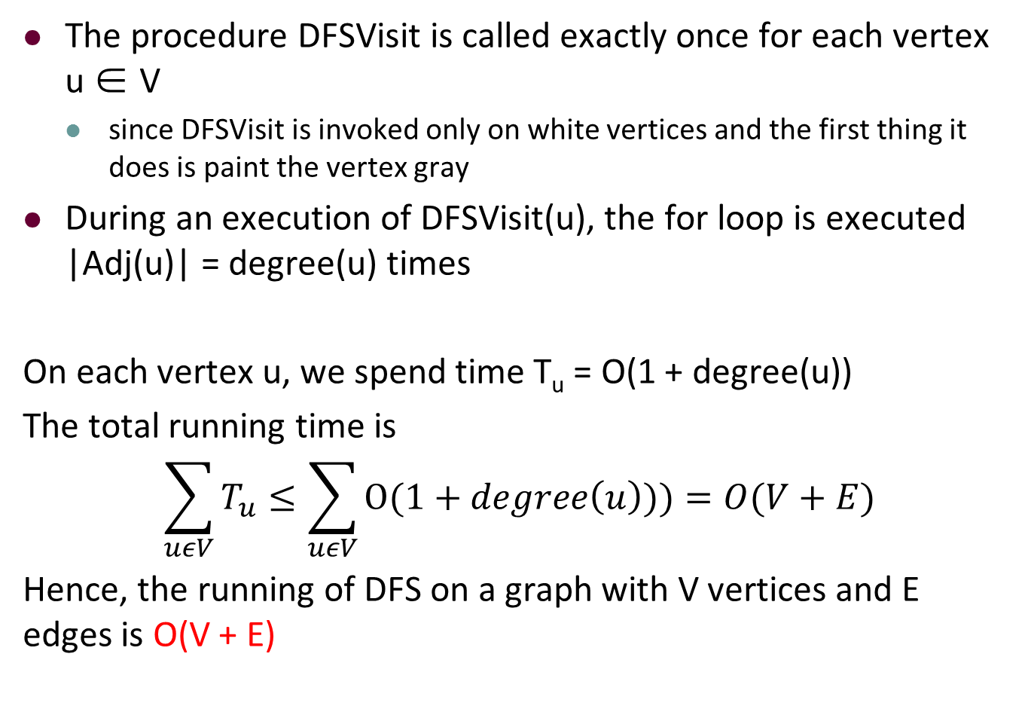
Running Time of DFS
The procedure DFSVisit is called exactly once for each vertex u ∈ V
since DFSVisit is invoked only on white vertices and the first thing it does is paint the vertex gray
During an execution of DFSVisit(u), the for loop is executed |Adj(u)| = degree(u) times
On each vertex u, we spend time T_{u} = O(1 + degree(u))
The total running time is
$$\sum_{uεV}{T_{u}≤\sum_{uεV}{O(1+degree\left(u\right)))=O(V+E)}}$$
Hence, the running of DFS on a graph with V vertices and E edges is O(V + E)

Slide 211
Time-Stamp (Parenthesis) Structure
1
2
3
4
2/5
1/16
7/14
8/13
3/4
6/15
10/11
9/12
5
6
7
8
Notes:
pə'rɛnθəsɪs

Slide 212
Time-Stamp (Parenthesis) Structure
1
2
3
4
2/5
1/16
7/14
8/13
3/4
6/15
10/11
9/12
5
6
7
8
2
1
6
5
3
4
8
7
1
2
3
4
5
6
7
8
9
10
11
12
13
14
15
16

Slide 213
Time-Stamp (Parenthesis) Structure
u is a descendant (in DFS trees) of v, if and only if [d[u], f [u]] is a subinterval of [d[v], f [v]]

Slide 214
Time-Stamp (Parenthesis) Structure
1
2
3
4
2/5
1/16
7/14
8/13
3/4
6/15
10/11
9/12
5
6
7
8
2
1
6
5
3
4
8
7
1
2
3
4
5
6
7
8
9
10
11
12
13
14
15
16

Slide 215
Time-Stamp (Parenthesis) Structure
u is a descendant (in DFS trees) of v, if and only if [d[u], f [u]] is a subinterval of [d[v], f [v]]
u is an ancestor of v, if and only if [d[u], f [u]] contains [d[v], f [v]]

Slide 216
Time-Stamp (Parenthesis) Structure
1
2
3
4
2/5
1/16
7/14
8/13
3/4
6/15
10/11
9/12
5
6
7
8
2
1
6
5
3
4
8
7
1
2
3
4
5
6
7
8
9
10
11
12
13
14
15
16

Slide 217
Time-Stamp (Parenthesis) Structure
u is a descendant (in DFS trees) of v, if and only if [d[u], f [u]] is a subinterval of [d[v], f [v]]
u is an ancestor of v, if and only if [d[u], f [u]] contains [d[v], f [v]]
u is unrelated to v, if and only if [d[u], f [u]] and [d[v], f [v]] are disjoint intervals

Slide 218
Time-Stamp (Parenthesis) Structure
1
2
3
4
2/5
1/16
7/14
8/13
3/4
6/15
10/11
9/12
5
6
7
8
2
1
6
5
3
4
8
7
1
2
3
4
5
6
7
8
9
10
11
12
13
14
15
16

Slide 219
Proof
The idea is to consider every case

Slide 220
Proof
The idea is to consider every case
We first consider d[v] < d[u]

Slide 221
Proof
The idea is to consider every case
We first consider d[v] < d[u]
If f[v] > d[u], then
u is discovered when v is still not finished yet (marked gray) ⇒ u is a descendant of v

Slide 222
Proof
The idea is to consider every case
We first consider d[v] < d[u]
If f[v] > d[u], then
u is discovered when v is still not finished yet (marked gray) ⇒ u is a descendant of v
u is discovered later than v ⇒ u should finish before v

Slide 223
Proof
The idea is to consider every case
We first consider d[v] < d[u]
If f[v] > d[u], then
u is discovered when v is still not finished yet (marked gray) ⇒ u is a descendant of v
u is discovered later than v ⇒ u should finish before v
Hence we have [d[u], f[u]] is a subinterval of [d[v], f[v]]

Slide 224
Proof
The idea is to consider every case
We first consider d[v] < d[u]
If f[v] > d[u], then
u is discovered when v is still not finished yet (marked gray) ⇒ u is a descendant of v
u is discovered later than v ⇒ u should finish before v
Hence we have [d[u], f[u]] is a subinterval of [d[v], f[v]]
If f[v] < d[u], then
obviously [d[v], f[v]] and [d[u], f[u]] are disjoint

Slide 225
Proof
The idea is to consider every case
We first consider d[v] < d[u]
If f[v] > d[u], then
u is discovered when v is still not finished yet (marked gray) ⇒ u is a descendant of v
u is discovered later than v ⇒ u should finish before v
Hence we have [d[u], f[u]] is a subinterval of [d[v], f[v]]
If f[v] < d[u], then
obviously [d[v], f[v]] and [d[u], f[u]] are disjoint
It means that when u or v is discovered, the others are not marked gray

Slide 226
Proof
The idea is to consider every case
We first consider d[v] < d[u]
If f[v] > d[u], then
u is discovered when v is still not finished yet (marked gray) ⇒ u is a descendant of v
u is discovered later than v ⇒ u should finish before v
Hence we have [d[u], f[u]] is a subinterval of [d[v], f[v]]
If f[v] < d[u], then
obviously [d[v], f[v]] and [d[u], f[u]] are disjoint
It means that when u or v is discovered, the others are not marked gray
Hence neither vertex is a descendant of the other

Slide 227
Proof
The idea is to consider every case
We first consider d[v] < d[u]
If f[v] > d[u], then
u is discovered when v is still not finished yet (marked gray) ⇒ u is a descendant of v
u is discovered later than v ⇒ u should finish before v
Hence we have [d[u], f[u]] is a subinterval of [d[v], f[v]]
If f[v] < d[u], then
obviously [d[v], f[v]] and [d[u], f[u]] are disjoint
It means that when u or v is discovered, the others are not marked gray
Hence neither vertex is a descendant of the other
The argument for other case, where d[v] > d[u], is similar

Slide 228
Tree Structure
Undirected graph G = (V, E), DFS forest F = (V, E_{f})
1
2
3
4
2/5
1/16
7/14
8/13
3/4
6/15
10/11
9/12
5
6
7
8

Slide 229
Tree Structure
Undirected graph G = (V, E), DFS forest F = (V, E_{f})
Consider (u, v) ∈ E
tree edge: if (u, v) ∈ E_{f} or equivalently u = pred[v], i.e. u is the predecessor of v in DFS trees
1
2
3
4
2/5
1/16
7/14
8/13
3/4
6/15
10/11
9/12
5
6
7
8

Slide 230
Tree Structure
Undirected graph G = (V, E), DFS forest F = (V, E_{f})
Consider (u, v) ∈ E
tree edge: if (u, v) ∈ E_{f} or equivalently u = pred[v], i.e. u is the predecessor of v in DFS trees
1
2
3
4
2/5
1/16
7/14
8/13
3/4
6/15
10/11
9/12
5
6
7
8

Slide 231
Tree Structure
Undirected graph G = (V, E), DFS forest F = (V, E_{f})
Consider (u, v) ∈ E
tree edge: if (u, v) ∈ E_{f} or equivalently u = pred[v], i.e. u is the predecessor of v in DFS trees
back edge: if v is an ancestor (excluding predecessor) of u in the DFS trees
1
2
3
4
2/5
1/16
7/14
8/13
3/4
6/15
10/11
9/12
5
6
7
8
Notes:
['priːdɪsesə]

Slide 232
Tree Structure
Undirected graph G = (V, E), DFS forest F = (V, E_{f})
Consider (u, v) ∈ E
tree edge: if (u, v) ∈ E_{f} or equivalently u = pred[v], i.e. u is the predecessor of v in DFS trees
back edge: if v is an ancestor (excluding predecessor) of u in the DFS trees
1
2
3
4
2/5
1/16
7/14
8/13
3/4
6/15
10/11
9/12
5
6
7
8

Slide 233
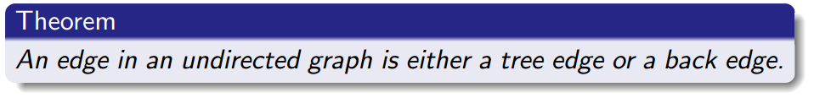
Tree Structure

Slide 234
Tree Structure
Proof:
Let (u, v) be an arbitrary edge in an undirected graph G.
Without loss of generality, assume d(u) < d(v).

Slide 235
Tree Structure
Proof:
Let (u, v) be an arbitrary edge in an undirected graph G.
Without loss of generality, assume d(u) < d(v).
Then v is discovered while u is gray.

Slide 236
Tree Structure
Proof:
Let (u, v) be an arbitrary edge in an undirected graph G.
Without loss of generality, assume d(u) < d(v).
Then v is discovered while u is gray.
Hence v is in the DFS subtree rooted at u.

Slide 237
Tree Structure
Proof:
Let (u, v) be an arbitrary edge in an undirected graph G.
Without loss of generality, assume d(u) < d(v).
Then v is discovered while u is gray.
Hence v is in the DFS subtree rooted at u.
If pred[v] = u, then (u, v) is a tree edge.

Slide 238
Tree Structure
Proof:
Let (u, v) be an arbitrary edge in an undirected graph G.
Without loss of generality, assume d(u) < d(v).
Then v is discovered while u is gray.
Hence v is in the DFS subtree rooted at u.
If pred[v] = u, then (u, v) is a tree edge.
if prev[v] ≠ u, then (u, v) is a back edge.

Slide 239
Outline
Introduction to Part IV
Review of Basic Graph Search Algorithms
Basic Concepts
The Breadth-First Search (BFS) Algorithm
The Depth-First Search (DFS) Algorithm
Topological Sort
The Topological Sort Algorithm
Analysis of the Topological Sort Algorithm
Strongly Connected Components
The Algorithm of Finding SCCs
Analysis of the Algorithm

Slide 240
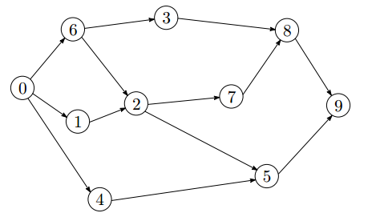
Directed Graph
For directed graph, we distinguish between edge (u, v) and edge (v, u)

Slide 241
Directed Graph
For directed graph, we distinguish between edge (u, v) and edge (v, u)
out-degree of a vertex is the number of edges leaving it

Slide 242
Directed Graph
For directed graph, we distinguish between edge (u, v) and edge (v, u)
out-degree of a vertex is the number of edges leaving it
in-degree of a vertex is the number of edges entering it

Slide 243
Directed Graph
For directed graph, we distinguish between edge (u, v) and edge (v, u)
out-degree of a vertex is the number of edges leaving it
in-degree of a vertex is the number of edges entering it
Each edge (u, v) contributes one to the out-degree of u and contributes one to the in-degree of v

Slide 244
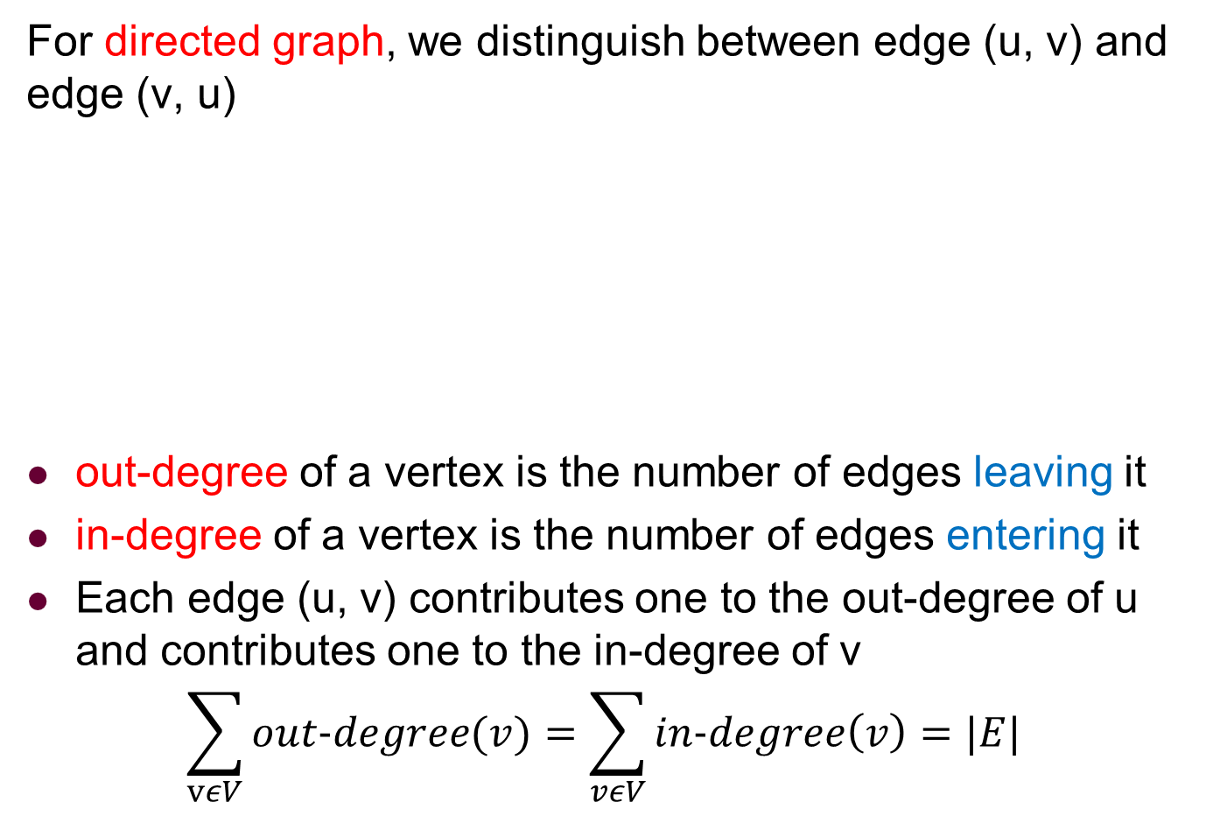
Directed Graph
For directed graph, we distinguish between edge (u, v) and edge (v, u)
out-degree of a vertex is the number of edges leaving it
in-degree of a vertex is the number of edges entering it
Each edge (u, v) contributes one to the out-degree of u and contributes one to the in-degree of v
$$\sum_{vεV}{out−degree(v)}=\sum_{vεV}{in−degree\left(v\right)}=|E|$$

Slide 245
Usage of Directed Graph
Directed graphs are often used to represent order-dependent tasks

Slide 246
Usage of Directed Graph
Directed graphs are often used to represent order-dependent tasks
That is, we cannot start a task before another task finishes

Slide 247
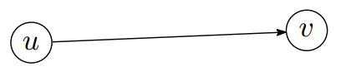
Usage of Directed Graph
Directed graphs are often used to represent order-dependent tasks
That is, we cannot start a task before another task finishes
An edge (u, v) means task v cannot start until task u is finished

Slide 248
Usage of Directed Graph
Directed graphs are often used to represent order-dependent tasks
That is, we cannot start a task before another task finishes
An edge (u, v) means task v cannot start until task u is finished
Clearly, for the system needs to hang, the graph must be acyclic
It must be a directed acyclic graph (or DAG)

Slide 249
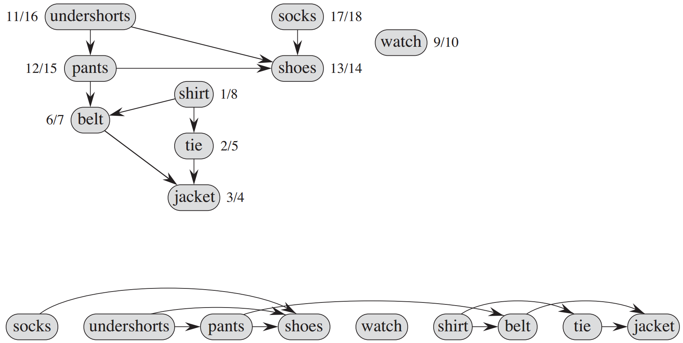
An Example

Slide 250
Topological Sort
Topological sort is an algorithm for a directed acyclic graph

Slide 251
Topological Sort
Topological sort is an algorithm for a directed acyclic graph
Linearly order the vertices so that for each edge (u, v) in the DAG, u appears before v in the linear ordering

Slide 252
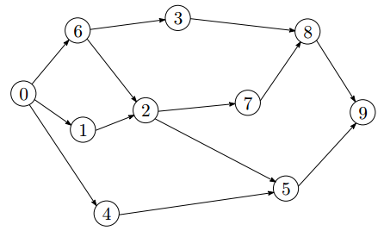
Topological Sort
Topological sort is an algorithm for a directed acyclic graph
Linearly order the vertices so that for each edge (u, v) in the DAG, u appears before v in the linear ordering

Slide 253
Topological Sort
Topological sort is an algorithm for a directed acyclic graph
Linearly order the vertices so that for each edge (u, v) in the DAG, u appears before v in the linear ordering
It may not be unique as there are many "equal" elements!

Slide 254
Topological Sort
Topological sort is an algorithm for a directed acyclic graph
Linearly order the vertices so that for each edge (u, v) in the DAG, u appears before v in the linear ordering
It may not be unique as there are many "equal" elements!
For the example, there are several topological orderings
0, 6, 1, 4, 3, 2, 5, 7, 8, 9
0, 4, 1, 6, 2, 5, 3, 7, 8, 9
…

Slide 255
Topological Sort Algorithm
Observations
Starting vertex must have zero in-degree

Slide 256
Topological Sort Algorithm
Observations
Starting vertex must have zero in-degree
If such a vertex doesn’t exist, the graph would not be acyclic

Slide 257
Topological Sort Algorithm
Observations
Starting vertex must have zero in-degree
If such a vertex doesn’t exist, the graph would not be acyclic
Main idea of the algorithm
A vertex with zero in-degree is a task that can start right away. So we can output it first in the linear order

Slide 258
Topological Sort Algorithm
Observations
Starting vertex must have zero in-degree
If such a vertex doesn’t exist, the graph would not be acyclic
Main idea of the algorithm
A vertex with zero in-degree is a task that can start right away. So we can output it first in the linear order
If a vertex u is output, then all the edges (u, v) are no longer useful, since tasks v do not need to wait for u anymore

Slide 259
Topological Sort Algorithm
Observations
Starting vertex must have zero in-degree
If such a vertex doesn’t exist, the graph would not be acyclic
Main idea of the algorithm
A vertex with zero in-degree is a task that can start right away. So we can output it first in the linear order
If a vertex u is output, then all the edges (u, v) are no longer useful, since tasks v do not need to wait for u anymore — remove all the edges (u, v) (u’s outgoing edges)

Slide 260
Topological Sort Algorithm
Observations
Starting vertex must have zero in-degree
If such a vertex doesn’t exist, the graph would not be acyclic
Main idea of the algorithm
A vertex with zero in-degree is a task that can start right away. So we can output it first in the linear order
If a vertex u is output, then all the edges (u, v) are no longer useful, since tasks v do not need to wait for u anymore — remove all the edges (u, v) (u’s outgoing edges)
With vertex u removed, the new graph is still a directed acyclic graph

Slide 261
Topological Sort Algorithm
Observations
Starting vertex must have zero in-degree
If such a vertex doesn’t exist, the graph would not be acyclic
Main idea of the algorithm
A vertex with zero in-degree is a task that can start right away. So we can output it first in the linear order
If a vertex u is output, then all the edges (u, v) are no longer useful, since tasks v do not need to wait for u anymore — remove all the edges (u, v) (u’s outgoing edges)
With vertex u removed, the new graph is still a directed acyclic graph — repeat steps 1-2 until no vertex is left

Slide 262
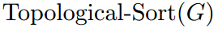
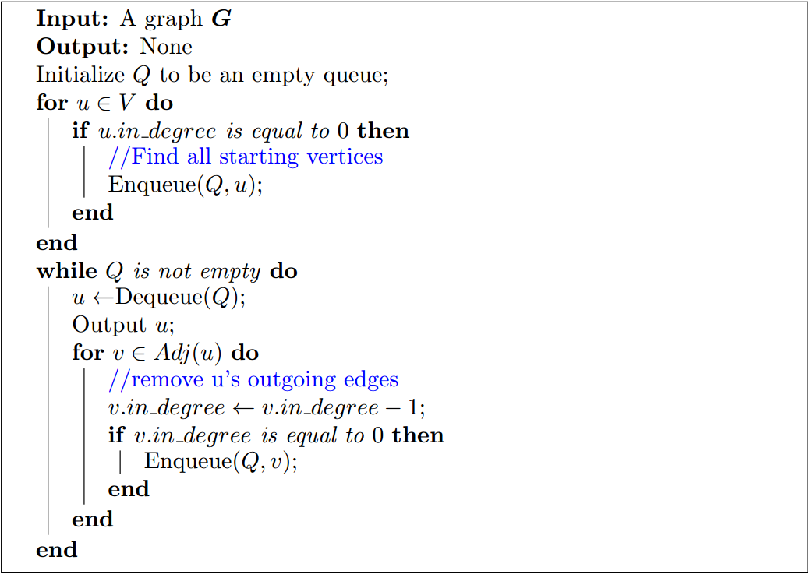
Topological Sort Algorithm

Slide 263
Topological Sort Example
Q
Output
3
6
8
7
2
9
0
1
5
4

Slide 264
Topological Sort Example
Q
Output
0
3
6
8
7
2
9
0
1
5
4

Slide 265
Topological Sort Example
Q
Output
0
3
6
8
7
2
9
0
1
5
4

Slide 266
Topological Sort Example
Q
Output
0
6
1
4
0
3
6
8
7
2
9
1
5
4

Slide 267
Topological Sort Example
Q
Output
0
6
1
4
0
3
6
8
7
2
9
1
5
4

Slide 268
Topological Sort Example
Q
Output
0
6
1
4
3
0
6
3
8
7
2
9
1
5
4

Slide 269
Topological Sort Example
Q
Output
0
6
1
4
3
0
6
3
8
7
2
9
1
5
4

Slide 270
Topological Sort Example
Q
Output
0
6
1
4
3
2
0
6
1
3
8
7
2
9
5
4

Slide 271
Topological Sort Example
Q
Output
0
6
1
4
3
2
0
6
1
3
8
7
2
9
5
4

Slide 272
Topological Sort Example
Q
Output
0
6
1
4
3
2
0
6
1
4
3
8
7
2
9
5

Slide 273
Topological Sort Example
Q
Output
0
6
1
4
3
2
0
6
1
4
3
8
7
2
9
5

Slide 274
Topological Sort Example
Q
Output
0
6
1
4
3
2
0
6
1
4
3
8
7
2
9
5

Slide 275
Topological Sort Example
Q
Output
0
6
1
4
3
2
0
6
1
4
3
8
7
2
9
5

Slide 276
Topological Sort Example
Q
Output
0
6
1
4
3
2
7
5
0
6
1
4
3
2
8
7
9
5

Slide 277
Topological Sort Example
Q
Output
0
6
1
4
3
2
7
5
0
6
1
4
3
2
8
7
9
5

Slide 278
Topological Sort Example
Q
Output
0
6
1
4
3
2
7
5
8
0
6
1
4
3
2
7
8
9
5

Slide 279
Topological Sort Example
Q
Output
0
6
1
4
3
2
7
5
8
0
6
1
4
3
2
7
8
9
5

Slide 280
Topological Sort Example
Q
Output
0
6
1
4
3
2
7
5
8
0
6
1
4
3
2
7
5
8
9

Slide 281
Topological Sort Example
Q
Output
0
6
1
4
3
2
7
5
8
0
6
1
4
3
2
7
5
8
9

Slide 282
Topological Sort Example
Q
Output
0
6
1
4
3
2
7
5
8
9
0
6
1
4
3
2
7
5
8
9

Slide 283
Topological Sort Example
Q
Output
0
6
1
4
3
2
7
5
8
9
0
6
1
4
3
2
7
5
8
9

Slide 284
Topological Sort Example
Q
Output
0
6
1
4
3
2
7
5
8
9
0
6
1
4
3
2
7
5
8
9

Slide 285
Outline
Introduction to Part V
Review of Basic Graph Search Algorithms
Basic Concepts
The Breadth-First Search (BFS) Algorithm
The Depth-First Search (DFS) Algorithm
Topological Sort
The Topological Sort Algorithm
Analysis of the Topological Sort Algorithm
Strongly Connected Components
The Algorithm of Finding SCCs
Analysis of the Algorithm

Slide 286
Correctness of Topological Sort Algorithm
For any vertex v, if it depends on a vertex u (i.e., edge (u, v) exists), then for v to appear in the linear ordering, all of its incoming edges must be removed so that it has zero in-degree.

Slide 287
Correctness of Topological Sort Algorithm
For any vertex v, if it depends on a vertex u (i.e., edge (u, v) exists), then for v to appear in the linear ordering, all of its incoming edges must be removed so that it has zero in-degree.
Therefore, v must appear after u in the linear ordering.

Slide 288
Topological Sort: Complexity
We never visit a vertex more than once

Slide 289
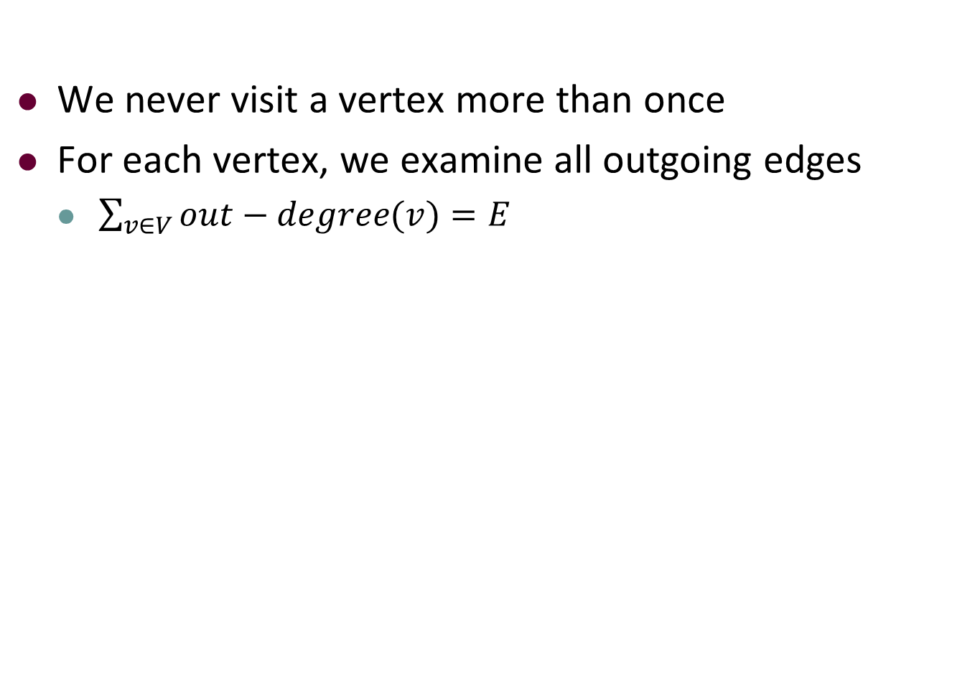
Topological Sort: Complexity
We never visit a vertex more than once
For each vertex, we examine all outgoing edges
$\sum_{v∈V}{out−degree(v)}=E$

Slide 290
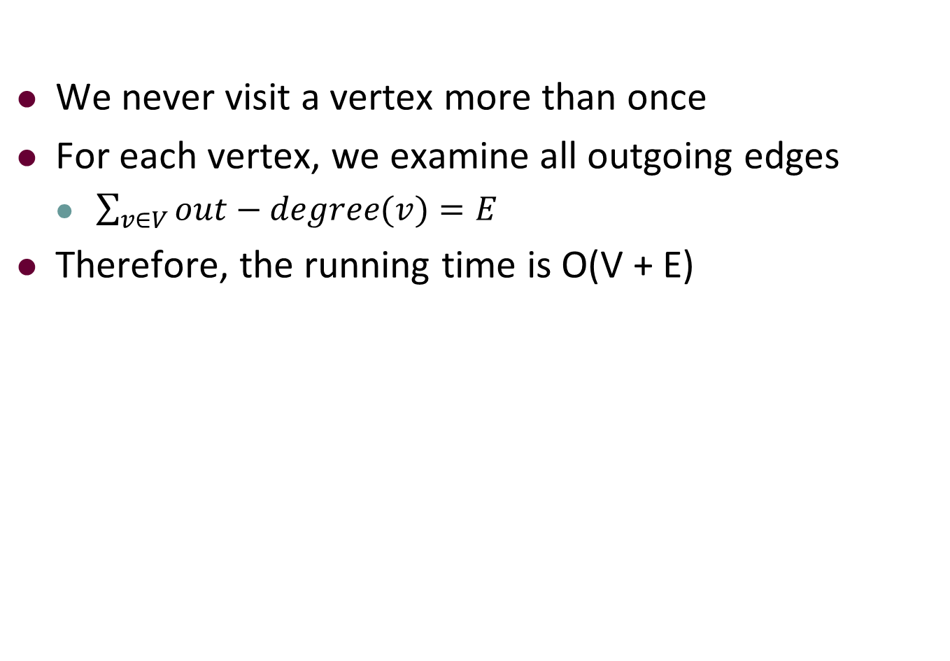
Topological Sort: Complexity
We never visit a vertex more than once
For each vertex, we examine all outgoing edges
$\sum_{v∈V}{out−degree(v)}=E$
Therefore, the running time is O(V + E)

Slide 291

Topological Sort: Complexity
We never visit a vertex more than once
For each vertex, we examine all outgoing edges
$\sum_{v∈V}{out−degree(v)}=E$
Therefore, the running time is O(V + E)

Slide 292
Outline
Introduction to Part IV
Review of Basic Graph Search Algorithms
Basic Concepts
The Breadth-First Search (BFS) Algorithm
The Depth-First Search (DFS) Algorithm
Topological Sort
The Topological Sort Algorithm
Analysis of the Topological Sort Algorithm
Strongly Connected Components
The Algorithm of Finding SCCs
Analysis of the Algorithm

Slide 293
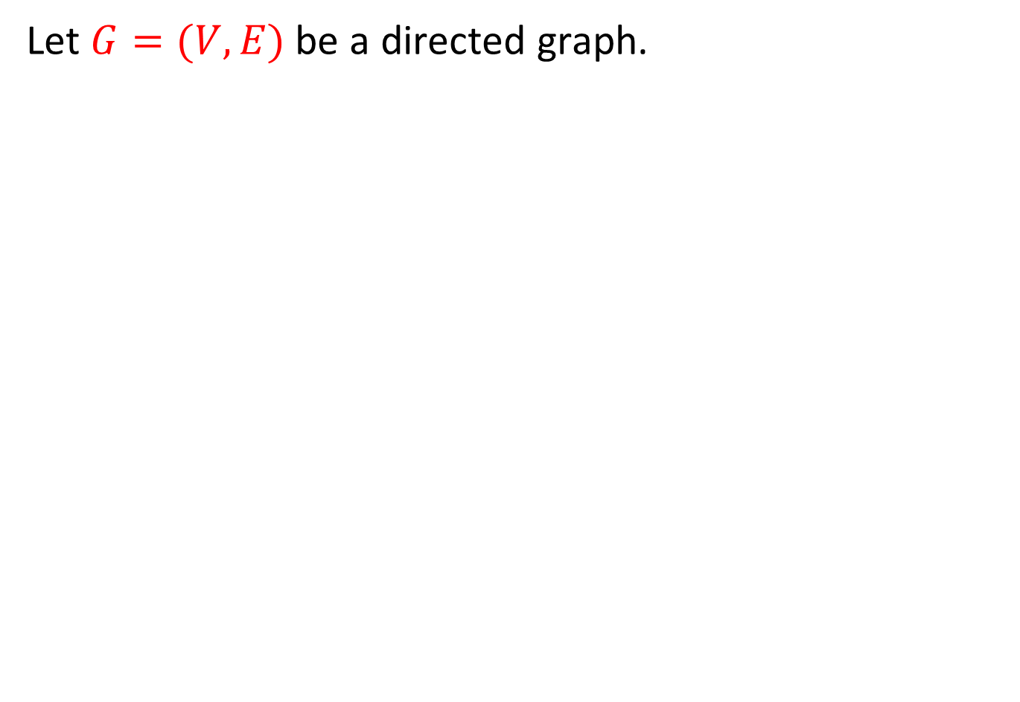
Strongly Connected Components
Let $G=(V,E)$ be a directed graph.

Slide 294
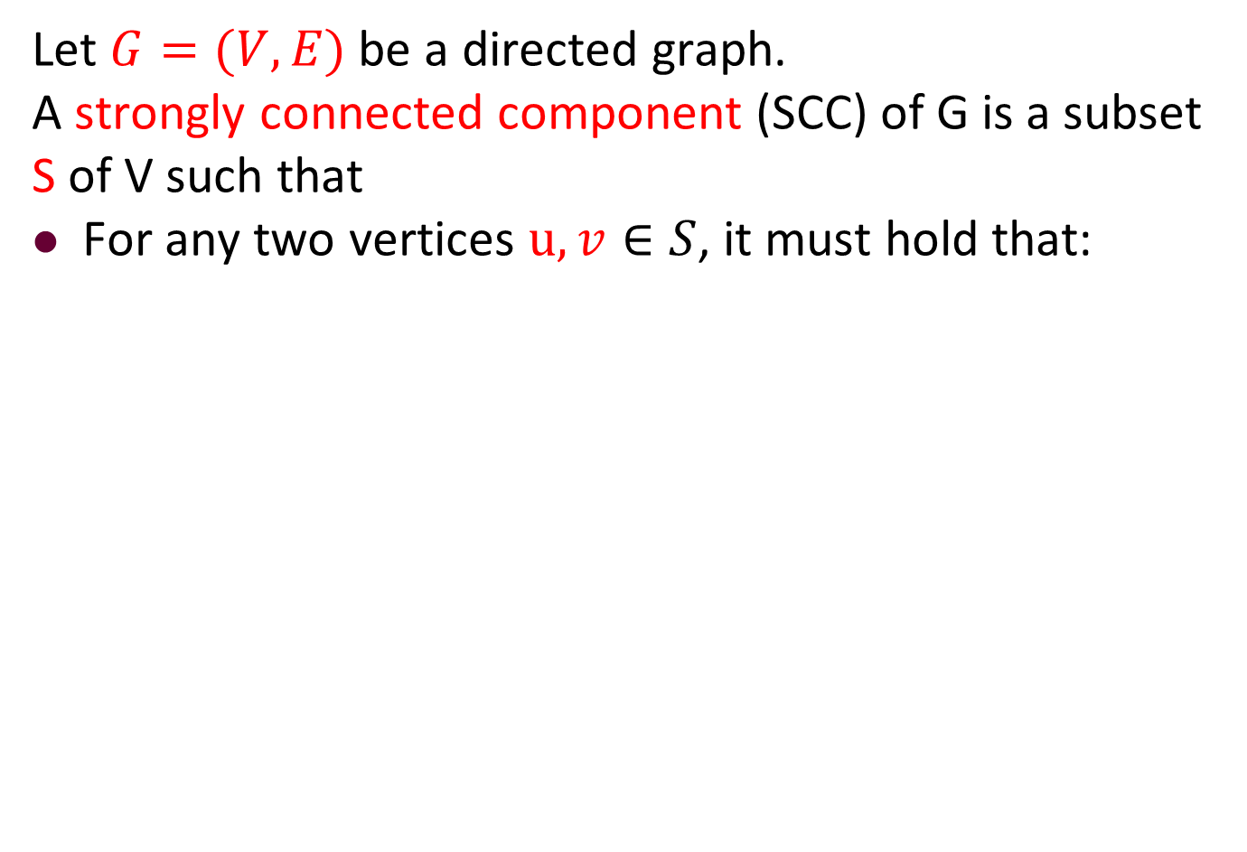
Strongly Connected Components
Let $G=(V,E)$ be a directed graph.
A strongly connected component (SCC) of G is a subset S of V such that
For any two vertices $u,v∈S$, it must hold that:

Slide 295
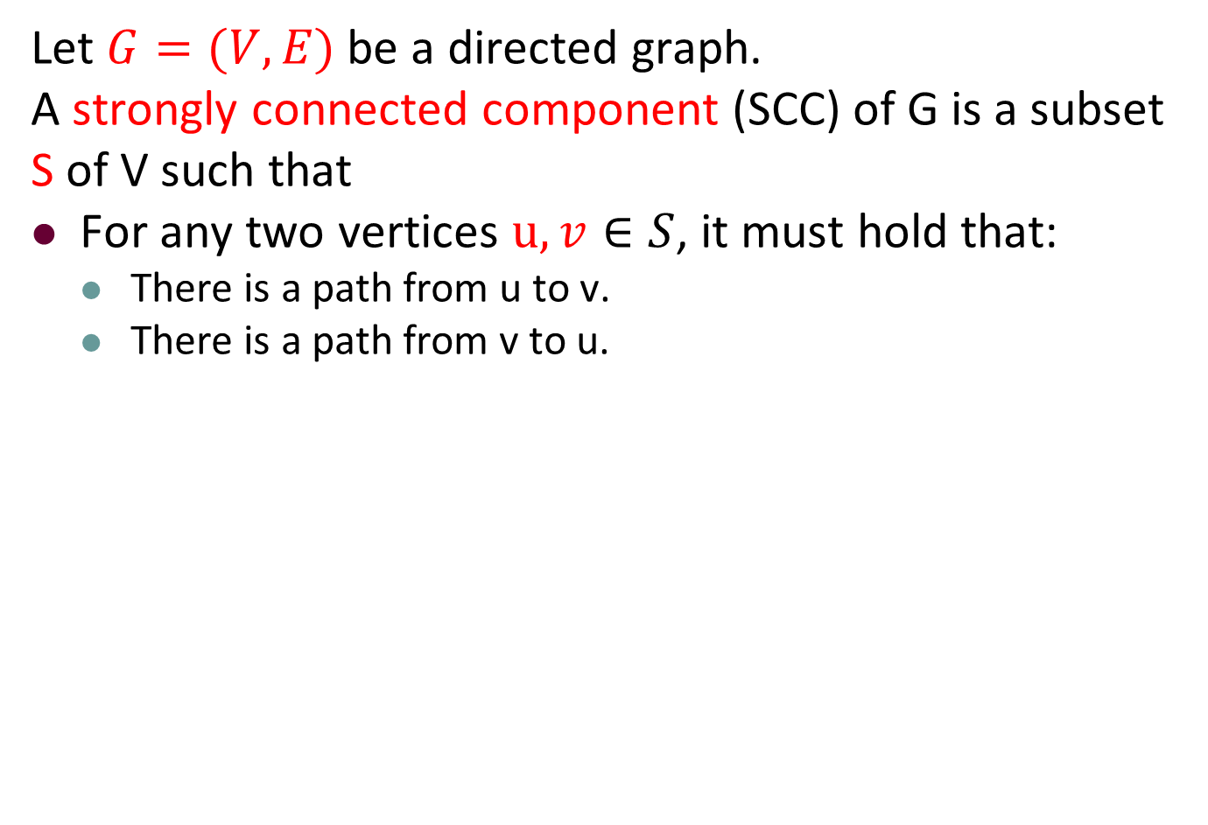
Strongly Connected Components
Let $G=(V,E)$ be a directed graph.
A strongly connected component (SCC) of G is a subset S of V such that
For any two vertices $u,v∈S$, it must hold that:
There is a path from u to v.
There is a path from v to u.

Slide 296
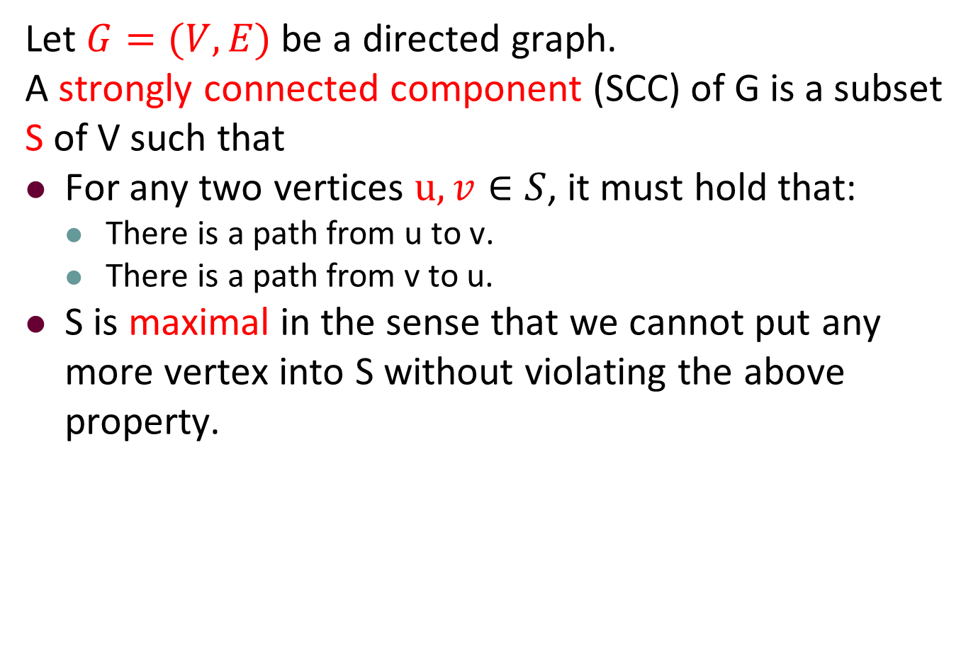
Strongly Connected Components
Let $G=(V,E)$ be a directed graph.
A strongly connected component (SCC) of G is a subset S of V such that
For any two vertices $u,v∈S$, it must hold that:
There is a path from u to v.
There is a path from v to u.
S is maximal in the sense that we cannot put any more vertex into S without violating the above property.

Slide 297
Example
Consider the following graph:
6
3
2
10
11
1
7
4
8
12
9
5

Slide 298
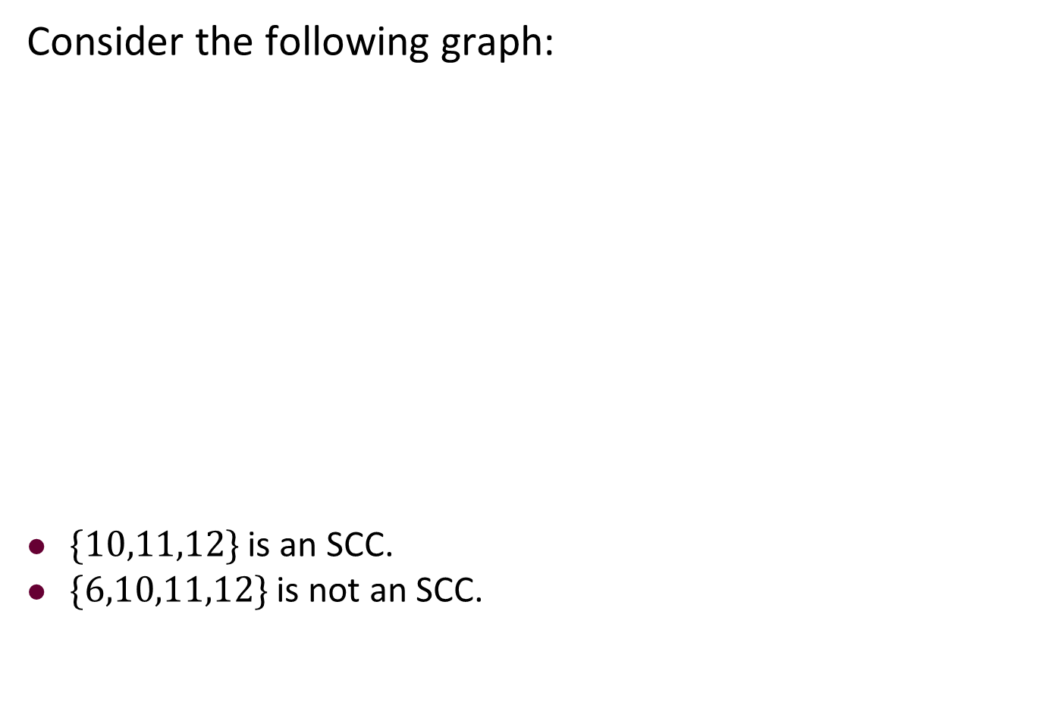
Example
Consider the following graph:
$\{10,11,12\}$ is an SCC.
$\{6,10,11,12\}$ is not an SCC.
6
3
2
10
11
1
7
4
8
12
9
5

Slide 299
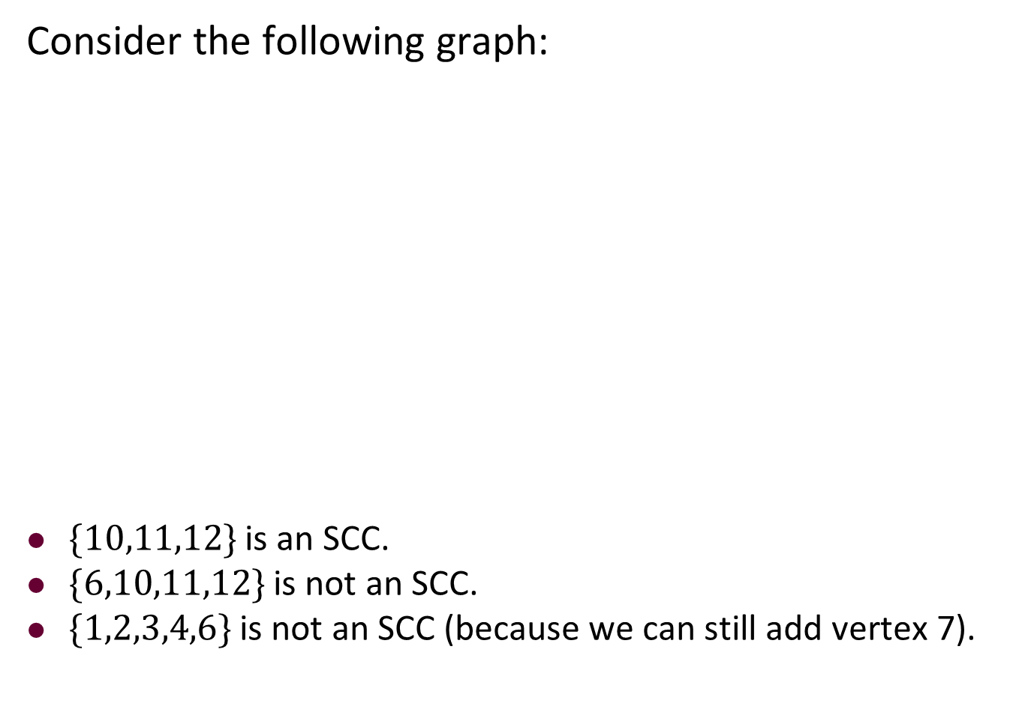
Example
Consider the following graph:
$\{10,11,12\}$ is an SCC.
$\{6,10,11,12\}$ is not an SCC.
$\{1,2,3,4,6\}$ is not an SCC (because we can still add vertex 7).
6
3
2
10
11
1
7
4
8
12
9
5

Slide 300
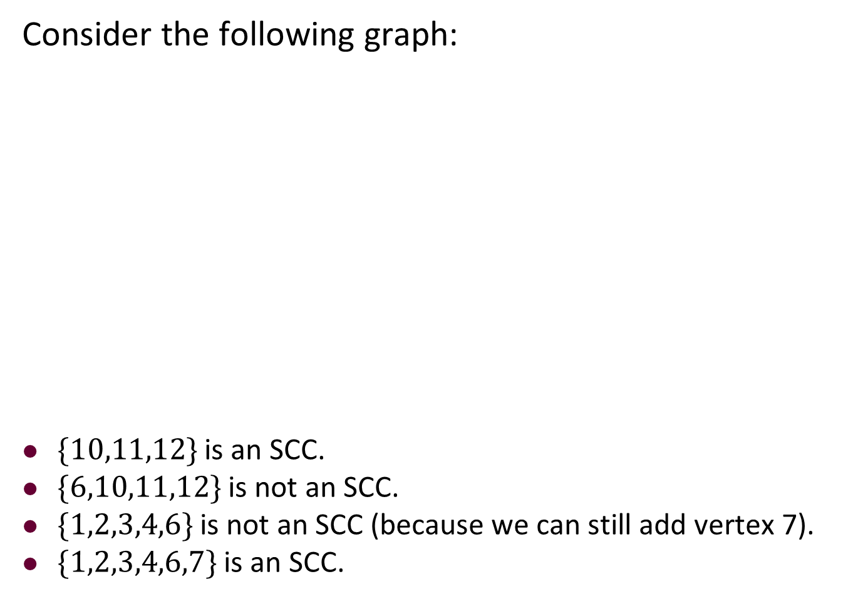
Example
Consider the following graph:
$\{10,11,12\}$ is an SCC.
$\{6,10,11,12\}$ is not an SCC.
$\{1,2,3,4,6\}$ is not an SCC (because we can still add vertex 7).
$\{1,2,3,4,6,7\}$ is an SCC.
6
3
2
10
11
1
7
4
8
12
9
5

Slide 301
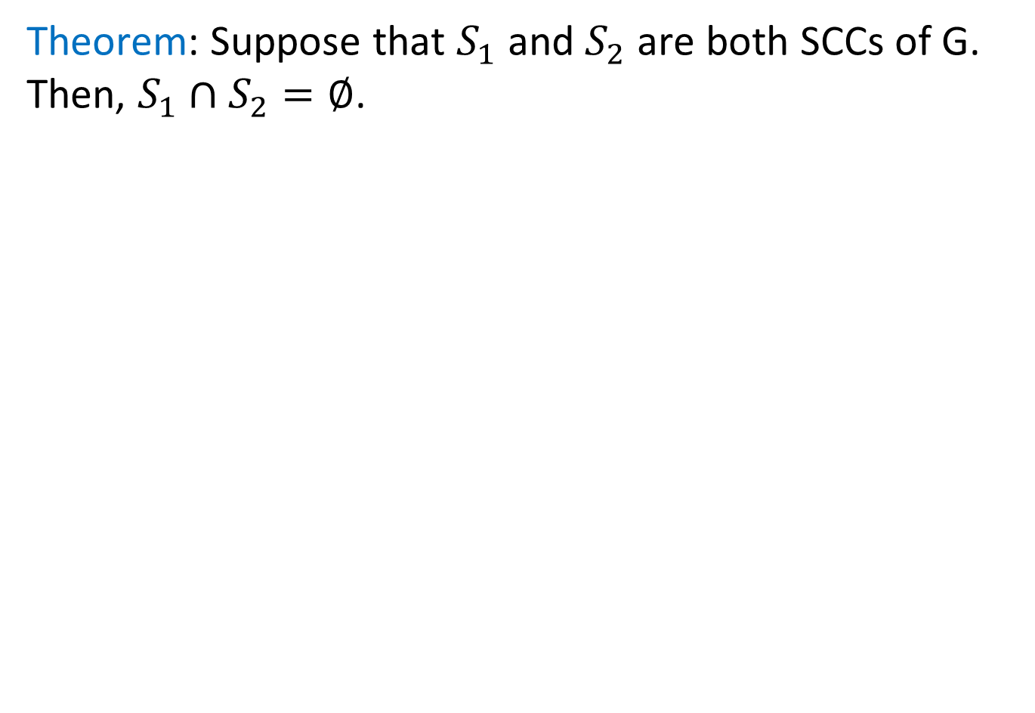
SCCs are Disjoint
Theorem: Suppose that $S_{1}$ and $S_{2}$ are both SCCs of G. Then, $S_{1}∩S_{2}=∅$.

Slide 302
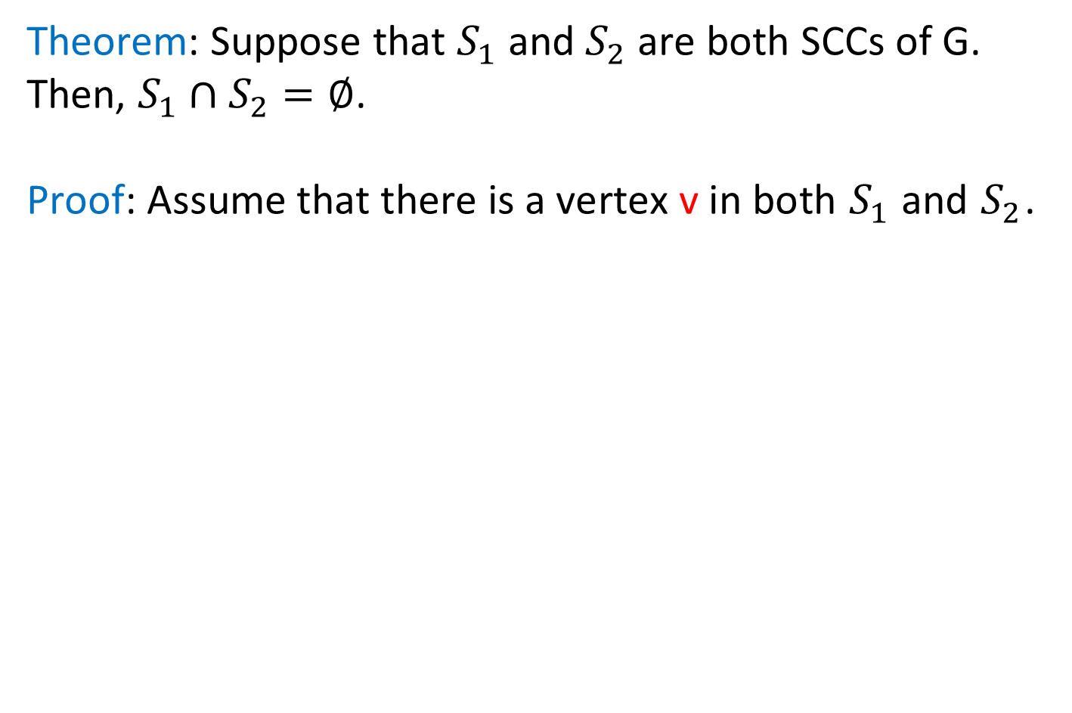
SCCs are Disjoint
Theorem: Suppose that $S_{1}$ and $S_{2}$ are both SCCs of G. Then, $S_{1}∩S_{2}=∅$.
Proof: Assume that there is a vertex v in both $S_{1}$ and $S_{2}$.

Slide 303
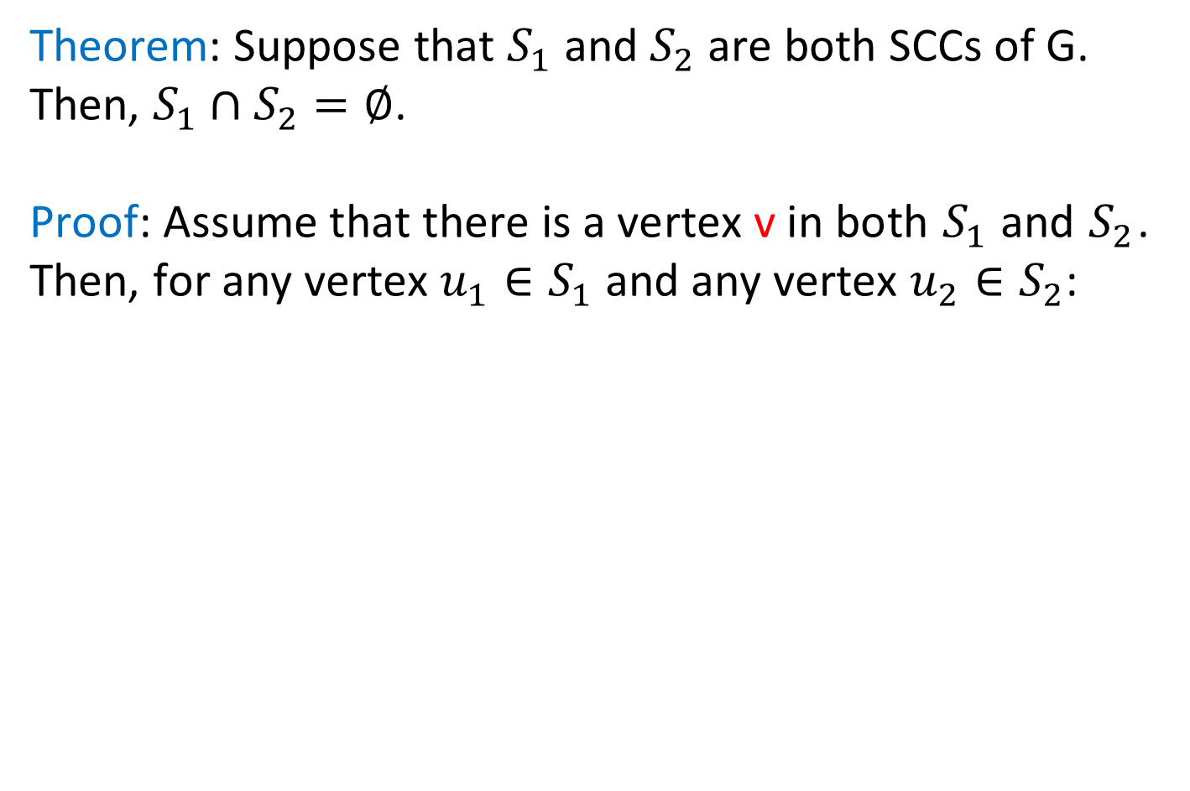
SCCs are Disjoint
Theorem: Suppose that $S_{1}$ and $S_{2}$ are both SCCs of G. Then, $S_{1}∩S_{2}=∅$.
Proof: Assume that there is a vertex v in both $S_{1}$ and $S_{2}$. Then, for any vertex $u_{1}∈S_{1}$ and any vertex $u_{2}∈S_{2}$:

Slide 304
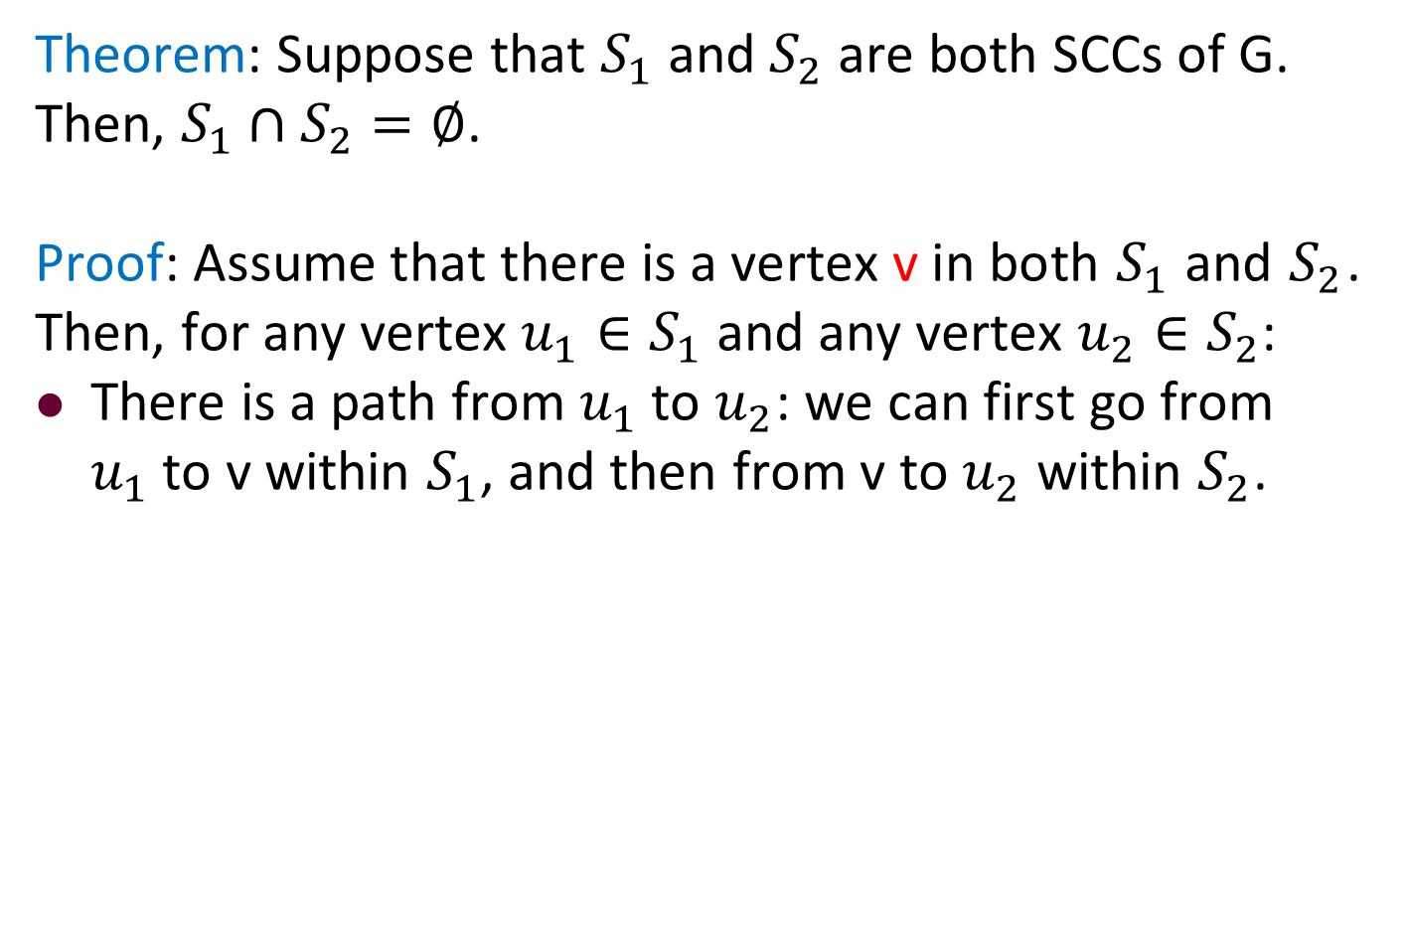
SCCs are Disjoint
Theorem: Suppose that $S_{1}$ and $S_{2}$ are both SCCs of G. Then, $S_{1}∩S_{2}=∅$.
Proof: Assume that there is a vertex v in both $S_{1}$ and $S_{2}$. Then, for any vertex $u_{1}∈S_{1}$ and any vertex $u_{2}∈S_{2}$:
There is a path from $u_{1}$ to $u_{2}$: we can first go from $u_{1}$ to v within $S_{1}$, and then from v to $u_{2}$ within $S_{2}$.

Slide 305
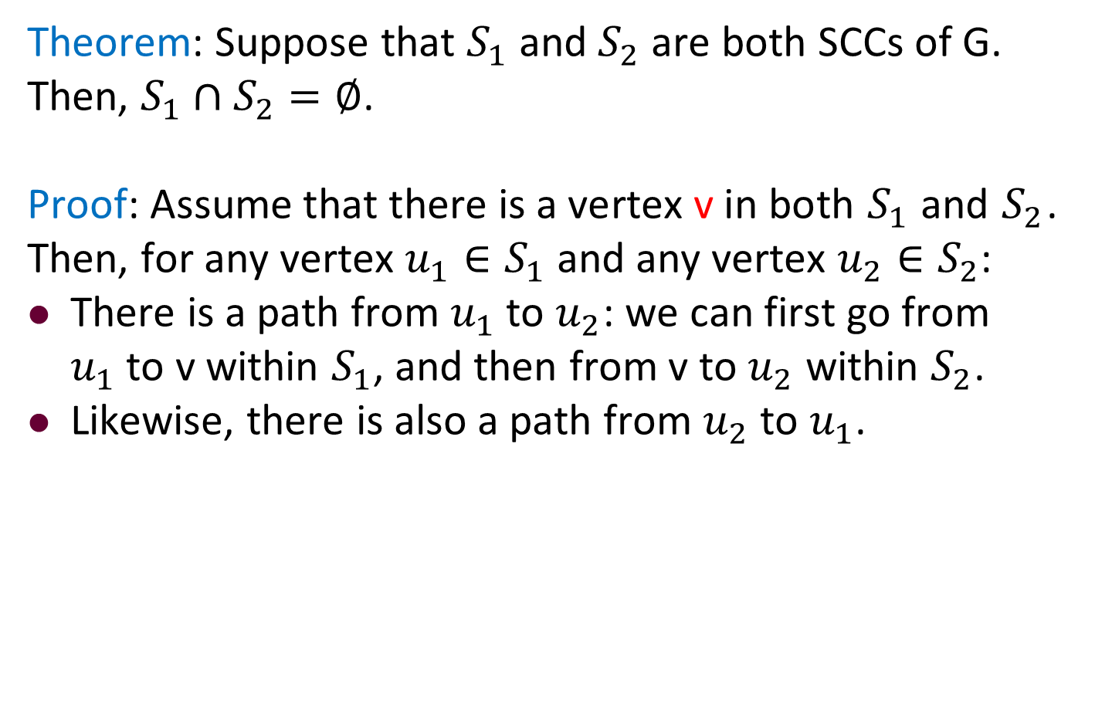
SCCs are Disjoint
Theorem: Suppose that $S_{1}$ and $S_{2}$ are both SCCs of G. Then, $S_{1}∩S_{2}=∅$.
Proof: Assume that there is a vertex v in both $S_{1}$ and $S_{2}$. Then, for any vertex $u_{1}∈S_{1}$ and any vertex $u_{2}∈S_{2}$:
There is a path from $u_{1}$ to $u_{2}$: we can first go from $u_{1}$ to v within $S_{1}$, and then from v to $u_{2}$ within $S_{2}$.
Likewise, there is also a path from $u_{2}$ to $u_{1}$.

Slide 306
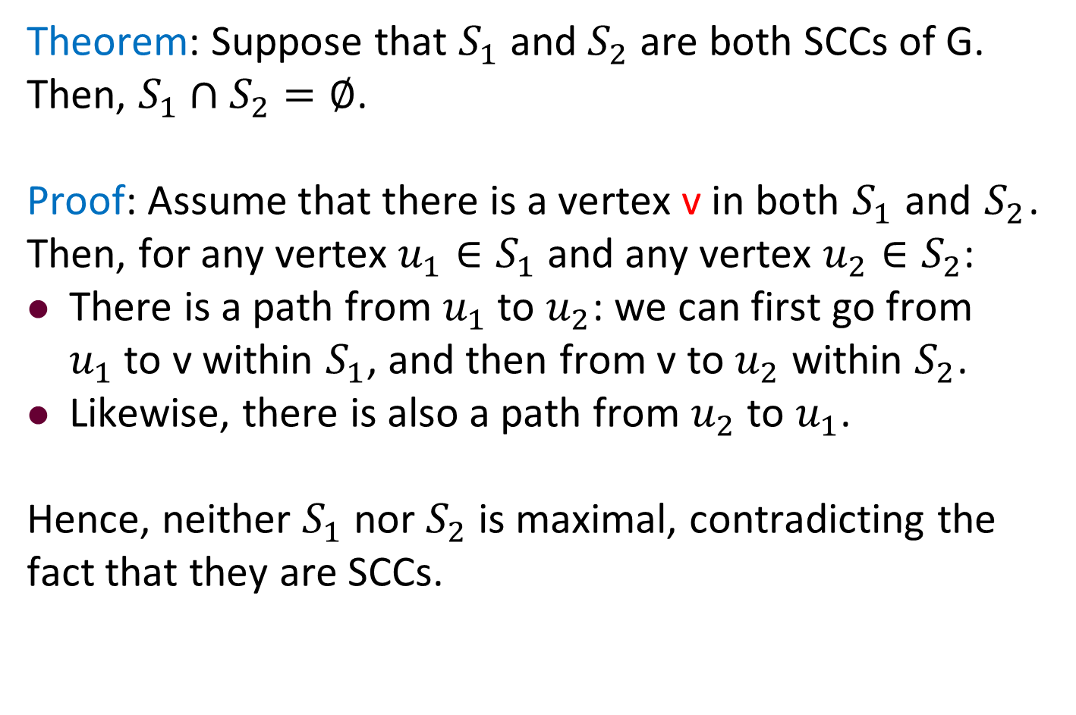
SCCs are Disjoint
Theorem: Suppose that $S_{1}$ and $S_{2}$ are both SCCs of G. Then, $S_{1}∩S_{2}=∅$.
Proof: Assume that there is a vertex v in both $S_{1}$ and $S_{2}$. Then, for any vertex $u_{1}∈S_{1}$ and any vertex $u_{2}∈S_{2}$:
There is a path from $u_{1}$ to $u_{2}$: we can first go from $u_{1}$ to v within $S_{1}$, and then from v to $u_{2}$ within $S_{2}$.
Likewise, there is also a path from $u_{2}$ to $u_{1}$.
Hence, neither $S_{1}$ nor $S_{2}$ is maximal, contradicting the fact that they are SCCs.

Slide 307
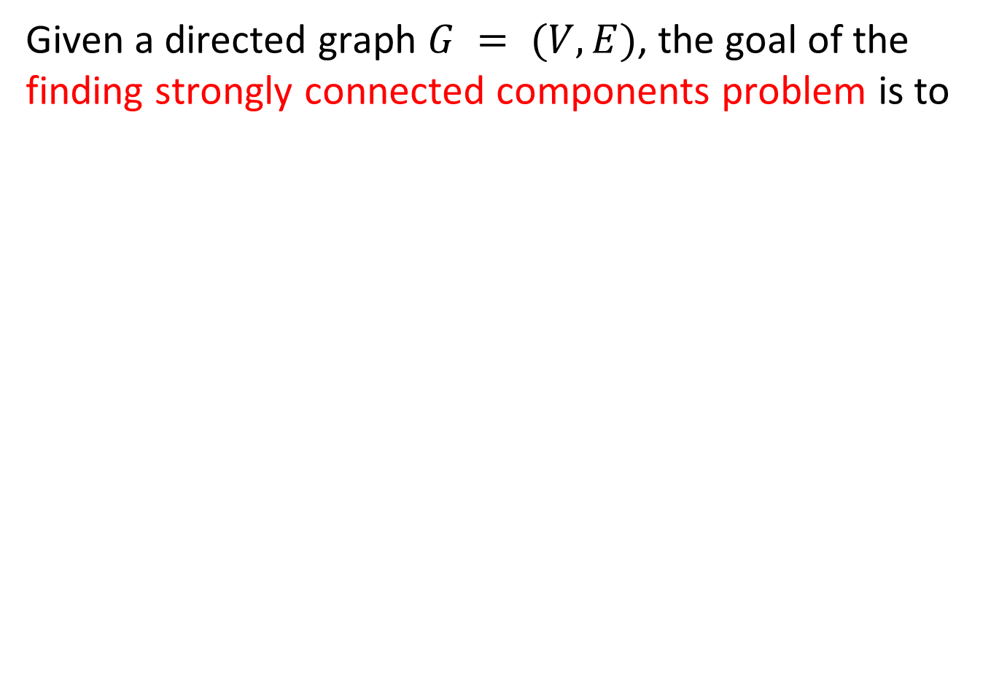
The Problem of Finding SCCs
Given a directed graph $G = (V,E)$, the goal of the finding strongly connected components problem is to

Slide 308

The Problem of Finding SCCs
Given a directed graph $G = (V,E)$, the goal of the finding strongly connected components problem is to divide V into disjoint subsets, each of which is an SCC.

Slide 309
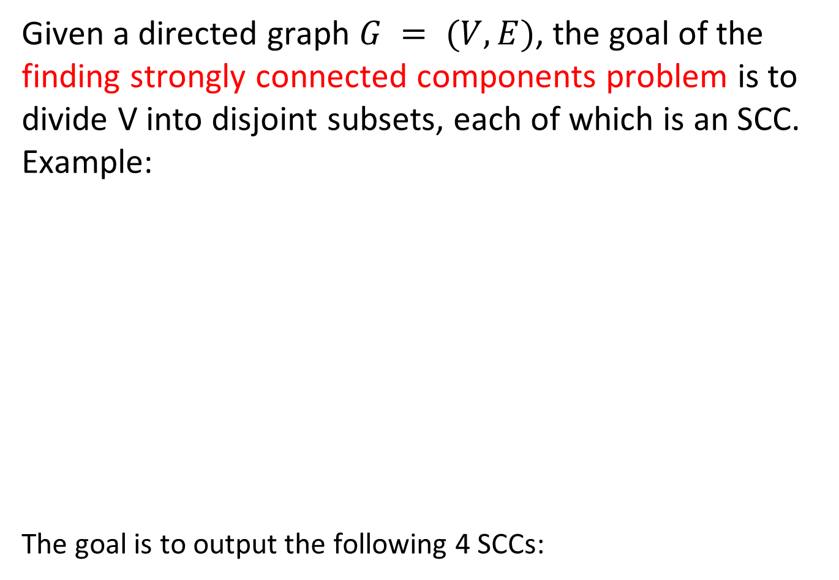
The Problem of Finding SCCs
Given a directed graph $G = (V,E)$, the goal of the finding strongly connected components problem is to divide V into disjoint subsets, each of which is an SCC.
Example:
The goal is to output the following 4 SCCs:
6
3
2
10
11
1
7
4
8
12
9
5

Slide 310
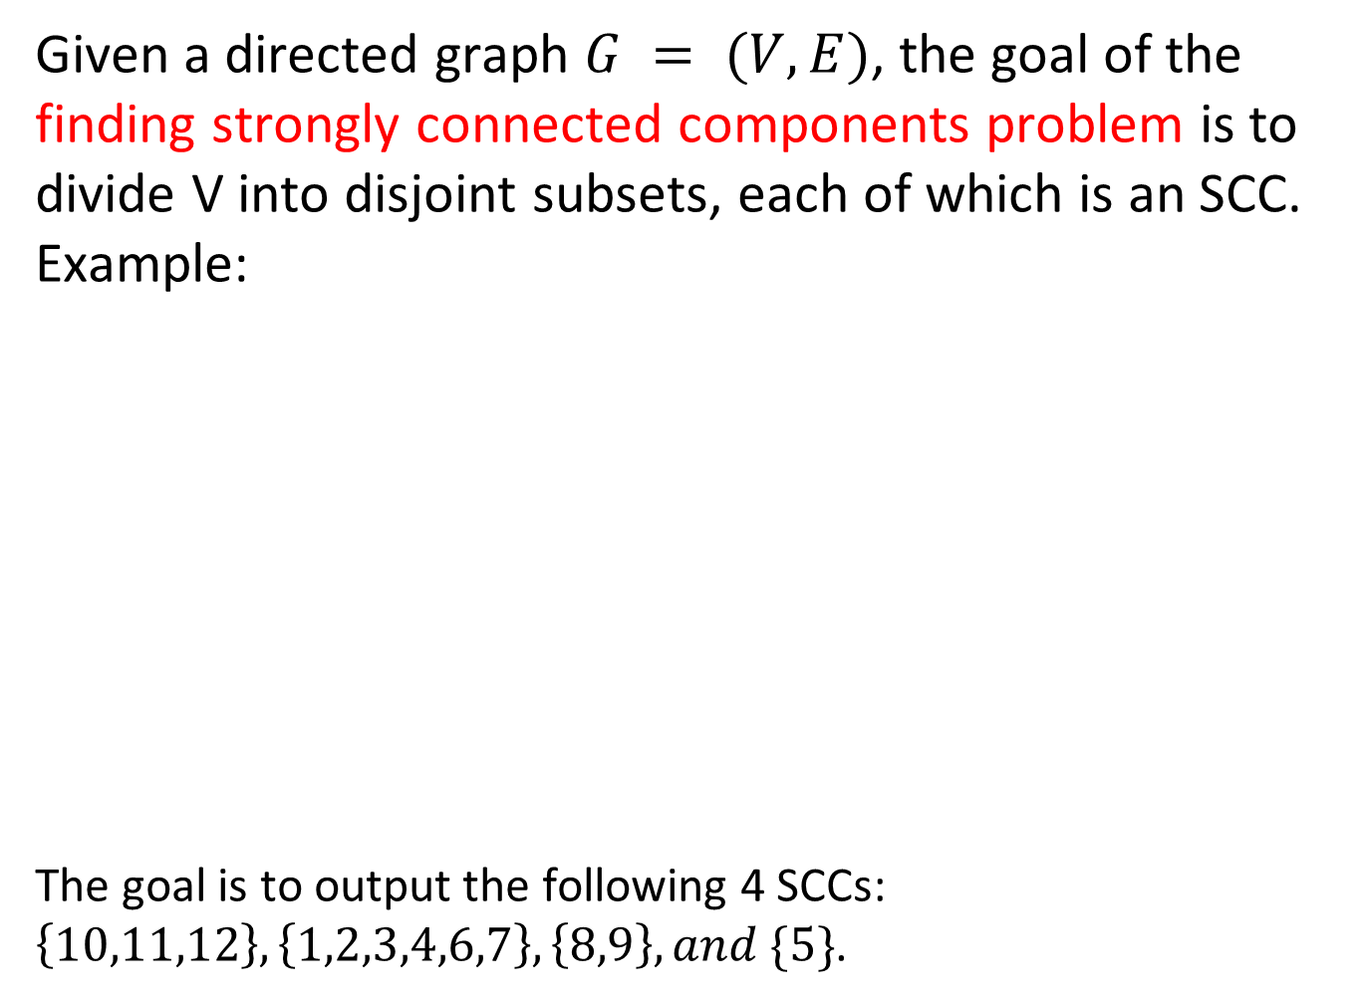
The Problem of Finding SCCs
Given a directed graph $G = (V,E)$, the goal of the finding strongly connected components problem is to divide V into disjoint subsets, each of which is an SCC.
Example:
The goal is to output the following 4 SCCs:
$\left\{10,11,12\right\},\left\{1,2,3,4,6,7\right\},\left\{8,9\right\}, and \{5\}$.
6
3
2
10
11
1
7
4
8
12
9
5

Slide 311


The Algorithm of Finding SCCs
Robert Tarjan
Robert Tarjan. Depth-First Search and Linear Graph Algorithms. SIAM Journal on Computing 1(2), 146-160, 1972. (CCF A类期刊)

Slide 312
Algorithm
Step 1: Obtain the reverse graph G^{R} by reversing the directions of all the edges in G.

Slide 313

SCC Example
The original graph $G$:
6
3
2
10
11
1
7
4
8
12
9
5

Slide 314
SCC Example
Obtain the reverse graph G^{R}:
6
3
2
10
11
1
7
4
8
12
9
5

Slide 315
Algorithm
Step 1: Obtain the reverse graph G^{R} by reversing the directions of all the edges in G.
Step 2: Perform DFS on G^{R},

Slide 316
Algorithm
Step 1: Obtain the reverse graph G^{R} by reversing the directions of all the edges in G.
Step 2: Perform DFS on G^{R}, and obtain the sequence L^{R} that the vertices in G^{R} turn black (i.e., whenever a vertex is popped out of the stack, append it to L^{R}).

Slide 317
Algorithm
Step 1: Obtain the reverse graph G^{R} by reversing the directions of all the edges in G.
Step 2: Perform DFS on G^{R}, and obtain the sequence L^{R} that the vertices in G^{R} turn black (i.e., whenever a vertex is popped out of the stack, append it to L^{R}). Obtain L as the reverse order of L^{R}.

Slide 318


SCC Example
Reverse graph $G^{R}$:
6
3
2
10
11
1
7
4
8
12
9
5
$$L^{R}$$

Slide 319
SCC Example
Reverse graph $G^{R}$:
6
3
2
10
11
Suppose that vertices are discovered by increasing order
1
7
4
8
12
9
5
$$L^{R}$$

Slide 320
SCC Example
Reverse graph $G^{R}$:
6
3
2
10
11
1
7
4
8
12
9
5
$$L^{R}$$

Slide 321
SCC Example
Reverse graph $G^{R}$:
6
3
2
10
11
1
7
4
8
12
9
5
$$L^{R}$$
3
2

Slide 322
SCC Example
Reverse graph $G^{R}$:
6
3
2
10
11
1
7
4
8
12
9
5
$$L^{R}$$
3
2

Slide 323
SCC Example
Reverse graph $G^{R}$:
6
3
2
10
11
1
7
4
8
12
9
5
$$L^{R}$$
3
2
5

Slide 324
SCC Example
Reverse graph $G^{R}$:
6
3
2
10
11
1
7
4
8
12
9
5
$$L^{R}$$
3
2
5

Slide 325
SCC Example
Reverse graph $G^{R}$:
6
3
2
10
11
1
7
4
8
12
9
5
$$L^{R}$$
3
2
5
9
8
7
6

Slide 326
SCC Example
Reverse graph $G^{R}$:
6
3
2
10
11
1
7
4
8
12
9
5
$$L^{R}$$
3
2
5
9
8
7
6
4
1

Slide 327
SCC Example
Reverse graph $G^{R}$:
6
3
2
10
11
1
7
4
8
12
9
5
$$L^{R}$$
3
2
5
9
8
7
6
4
1

Slide 328
SCC Example
Reverse graph $G^{R}$:
6
3
2
10
11
1
7
4
8
12
9
5
$$L^{R}$$
3
2
5
9
8
7
6
4
1
12
11
10

Slide 329

SCC Example
Reverse graph $G^{R}$:
6
3
2
10
11
1
7
4
8
12
9
5
$$L^{R}$$
3
2
5
9
8
7
6
4
1
12
11
10
$$L$$
10
11
12
1
4
6
7
8
9
5
2
3

Slide 330
Algorithm
Step 1: Obtain the reverse graph G^{R} by reversing the directions of all the edges in G.
Step 2: Perform DFS on G^{R}, and obtain the sequence L^{R} that the vertices in G^{R} turn black (i.e., whenever a vertex is popped out of the stack, append it to L^{R}). Obtain L as the reverse order of L^{R}.
Step 3: Perform DFS on the original graph G by obeying the following rules:

Slide 331
Algorithm
Step 1: Obtain the reverse graph G^{R} by reversing the directions of all the edges in G.
Step 2: Perform DFS on G^{R}, and obtain the sequence L^{R} that the vertices in G^{R} turn black (i.e., whenever a vertex is popped out of the stack, append it to L^{R}). Obtain L as the reverse order of L^{R}.
Step 3: Perform DFS on the original graph G by obeying the following rules:
Rule 1: Start the DFS at the first vertex of L.

Slide 332
Algorithm
Step 1: Obtain the reverse graph G^{R} by reversing the directions of all the edges in G.
Step 2: Perform DFS on G^{R}, and obtain the sequence L^{R} that the vertices in G^{R} turn black (i.e., whenever a vertex is popped out of the stack, append it to L^{R}). Obtain L as the reverse order of L^{R}.
Step 3: Perform DFS on the original graph G by obeying the following rules:
Rule 1: Start the DFS at the first vertex of L.
Rule 2: Whenever a restart is needed, start from the first vertex of L that is still white.

Slide 333
Algorithm
Step 1: Obtain the reverse graph G^{R} by reversing the directions of all the edges in G.
Step 2: Perform DFS on G^{R}, and obtain the sequence L^{R} that the vertices in G^{R} turn black (i.e., whenever a vertex is popped out of the stack, append it to L^{R}). Obtain L as the reverse order of L^{R}.
Step 3: Perform DFS on the original graph G by obeying the following rules:
Rule 1: Start the DFS at the first vertex of L.
Rule 2: Whenever a restart is needed, start from the first vertex of L that is still white.
Output the vertices in each DFS-tree as an SCC.

Slide 334

SCC Example
The original graph $G$:
6
3
2
10
11
1
7
4
8
12
9
5
$$L$$
10
11
12
1
4
6
7
8
9
5
2
3

Slide 335
SCC Example
The original graph $G$:
6
3
2
10
11
1
7
4
8
12
9
5
$$L$$
10
11
12
1
4
6
7
8
9
5
2
3

Slide 336
SCC Example
The original graph $G$:
6
3
2
10
11
1
7
4
8
12
9
5
$$L$$
10
11
12
1
4
6
7
8
9
5
2
3

Slide 337
SCC Example
The original graph $G$:
6
3
2
10
11
1
7
4
8
12
9
5
$$L$$
10
11
12
1
4
6
7
8
9
5
2
3

Slide 338
SCC Example
The original graph $G$:
6
3
2
10
11
1
7
4
8
12
9
5
$$L$$
10
11
12
1
4
6
7
8
9
5
2
3

Slide 339
SCC Example
The original graph $G$:
6
3
2
10
11
1
7
4
8
12
9
5
$$L$$
10
11
12
1
4
6
7
8
9
5
2
3

Slide 340
SCC Example
The original graph $G$:
6
3
2
10
11
1
7
4
8
12
9
5
$$L$$
10
11
12
1
4
6
7
8
9
5
2
3

Slide 341
SCC Example
The original graph $G$:
6
3
2
10
11
1
7
4
8
12
9
5
$$L$$
10
11
12
1
4
6
7
8
9
5
2
3

Slide 342
SCC Example
The original graph $G$:
6
3
2
10
11
1
7
4
8
12
9
5
$$L$$
10
11
12
1
4
6
7
8
9
5
2
3

Slide 343
SCC Example
The original graph $G$:
6
3
2
10
11
1
7
4
8
12
9
5
$$L$$
10
11
12
1
4
6
7
8
9
5
2
3

Slide 344
SCC Example
The original graph $G$:
6
3
2
10
11
1
7
4
8
12
9
5
$$L$$
10
11
12
1
4
6
7
8
9
5
2
3

Slide 345
SCC Example
The original graph $G$:
6
3
2
10
11
1
7
4
8
12
9
5
$$L$$
10
11
12
1
4
6
7
8
9
5
2
3

Slide 346

SCC Example
The original graph $G$:
Graph $G$ contains 4 SCCs:
$$\left\{10,11,12\right\},\left\{1,2,3,4,6,7\right\},\left\{8,9\right\},\{5\}$$
6
3
2
10
11
1
7
4
8
12
9
5

Slide 347


Pseudocode

Slide 348
Pseudocode

Slide 349
Pseudocode

Slide 350
Pseudocode

Slide 351
Pseudocode

Slide 352
Pseudocode

Slide 353
Pseudocode

Slide 354
Pseudocode

Slide 355
Outline
Introduction to Part IV
Review of Basic Graph Search Algorithms
Basic Concepts
The Breadth-First Search (BFS) Algorithm
The Depth-First Search (DFS) Algorithm
Topological Sort
The Topological Sort Algorithm
Analysis of the Topological Sort Algorithm
Strongly Connected Components
The Algorithm of Finding SCCs
Analysis of the Algorithm

Slide 356

Time Analysis
Steps 1 and 2 obviously require only $O(\left|V\right|+|E|)$ time.

Slide 357

Time Analysis
Steps 1 and 2 obviously require only $O(\left|V\right|+|E|)$ time.
Regarding Step 3, the DFS itself takes $O(\left|V\right|+|E|)$ time, but we still need to discuss the time to implement Rule 2.

Slide 358

Time Analysis
Steps 1 and 2 obviously require only $O(\left|V\right|+|E|)$ time.
Regarding Step 3, the DFS itself takes $O(\left|V\right|+|E|)$ time, but we still need to discuss the time to implement Rule 2. Namely, whenever DFS needs a restart, how do we find the first white vertex in L efficiently? This will be left as an exercise.

Slide 359

Time Analysis
Steps 1 and 2 obviously require only $O(\left|V\right|+|E|)$ time.
Regarding Step 3, the DFS itself takes $O(\left|V\right|+|E|)$ time, but we still need to discuss the time to implement Rule 2. Namely, whenever DFS needs a restart, how do we find the first white vertex in L efficiently? This will be left as an exercise.
Hence, the overall execution time is $O(\left|V\right|+|E|)$.

Slide 360

SCC Graph
Let G be the input directed graph, with SCCs $S_{1},S_{2},…,S_{t}$ for some t ≥ 1.
Let us define a SCC graph G^{SCC} as follows:

Slide 361

SCC Graph
Let G be the input directed graph, with SCCs $S_{1},S_{2},…,S_{t}$ for some t ≥ 1.
Let us define a SCC graph G^{SCC} as follows:
Each vertex in G^{SCC} is a distinct SCC in G.

Slide 362

SCC Graph
Let G be the input directed graph, with SCCs $S_{1},S_{2},…,S_{t}$ for some t ≥ 1.
Let us define a SCC graph G^{SCC} as follows:
Each vertex in G^{SCC} is a distinct SCC in G.
Consider two vertices (a.k.a. SCCs) S_{i} and S_{j} (1 ≤ i,j ≤ t). G^{SCC} has an edge from S_{i} to S_{j} if and only if

Slide 363

SCC Graph
Let G be the input directed graph, with SCCs $S_{1},S_{2},…,S_{t}$ for some t ≥ 1.
Let us define a SCC graph G^{SCC} as follows:
Each vertex in G^{SCC} is a distinct SCC in G.
Consider two vertices (a.k.a. SCCs) S_{i} and S_{j} (1 ≤ i,j ≤ t). G^{SCC} has an edge from S_{i} to S_{j} if and only if
i ≠ j, and
There is a path in G from a vertex in S_{i} to a vertex in S_{j}.

Slide 364





SCC Graph - Example
$$S_{2}$$
6
$$S_{1}$$
3
2
10
11
1
7
4
8
12
9
5
$$S_{3}$$
$$S_{4}$$

Slide 365
SCC Graph
Lemma: G^{SCC} is a DAG.
Proof: Suppose that there is a cycle in G^{SCC}, which must involve at least 2 SCCs (say S_{i}, S_{j}) as no vertex in G^{SCC} has an edge to itself.

Slide 366
SCC Graph
Lemma: G^{SCC} is a DAG.
Proof: Suppose that there is a cycle in G^{SCC}, which must involve at least 2 SCCs (say S_{i}, S_{j}) as no vertex in G^{SCC} has an edge to itself.
Then, any vertex in S_{i} is reachable from any vertex in S_{j}, and vice versa. This violates the fact that S_{i}, S_{j} are SCCs (violating maximality).

Slide 367
SCC Graph
Define an SCC as a sink SCC if it has no outgoing edge in G^{SCC}.
Lemma: There must be at least one sink SCC in G^{SCC}.

Slide 368
SCC Graph
Define an SCC as a sink SCC if it has no outgoing edge in G^{SCC}.
Lemma: There must be at least one sink SCC in G^{SCC}.
Proof: Since G^{SCC} is a DAG, it admits a topological order. The last vertex of the topological order cannot have any outgoing edges.

Slide 369
SCC Graph - Example
S₁ is a sink vertex.
$$S_{2}$$
6
$$S_{1}$$
3
2
10
11
1
7
4
8
12
9
5
$$S_{3}$$
$$S_{4}$$

Slide 370
DFS in a Sink SCC
Lemma: Let S be a sink SCC of G^{SCC}. Suppose that we perform a DFS starting from any vertex in S. Then the first DFS-tree output must include all and only the vertices in S.

Slide 371

DFS in a Sink SCC
Lemma: Let S be a sink SCC of G^{SCC}. Suppose that we perform a DFS starting from any vertex in S. Then the first DFS-tree output must include all and only the vertices in S.
Proof: Let $v∈S$ be the starting vertex of DFS. By the visiting process of DFS, the DFS-tree must include all the vertices that v can reach. These are exactly the vertices in S.

Slide 372
DFS in a Sink SCC - Example
Performing DFS from any vertex in S₁ will discover S₁ as the first SCC.
$$S_{2}$$
6
$$S_{1}$$
3
2
10
11
1
7
4
8
12
9
5
$$S_{3}$$
$$S_{4}$$

Slide 373
Finding SCCs - The Strategy
The previous lemma suggests the following strategy for finding all the SCCs:
Performing DFS from any vertex in a sink SCC S.
Delete all the vertices of S from G, as well as their edges.
Accordingly, delete S from G^{SCC}, as well as its edges.
Repeat from Step 1, until G is empty.

Slide 374
Finding SCCs - Example
After deleting S₁, we have:
Now, S₂ becomes the sink SCC. Performing DFS from any vertex in S₂ discovers S₂ as the second SCC.
$$S_{2}$$
6
3
2
1
7
4
8
9
5
$$S_{3}$$
$$S_{4}$$

Slide 375
Finding SCCs - Example
After deleting S₂, we have:
Now, S₃ becomes the sink SCC. Performing DFS from any vertex in S₃ discovers S₃ as the third SCC.
8
9
5
$$S_{3}$$
$$S_{4}$$

Slide 376
Finding SCCs - Example
After deleting S₃, we have:
Now, S₄ becomes the sink SCC. Performing DFS from any vertex in S₄ discovers S₄ as the last SCC.
5
$$S_{4}$$

Slide 377
Correctness
A Property of the Ordering L
Lemma: Let S₁, S₂ be SCCs such that there is a path from S₁ to S₂ in G^{SCC}. In the ordering of L, the earliest vertex in S₂ must come before the earliest vertex in S₁.

Slide 378





Correctness - Example
$$S_{2}$$
Recall that we obtained earlier
$L=(10,11,12,1,4,6,7,8,9,5,3,2)$. The red vertices 10,1,8,5 are, respectively, the earliest vertex in L of S₁, S₂, S₃, and S₄.
6
$$S_{1}$$
3
2
10
11
1
7
4
8
12
9
5
$$S_{3}$$
$$S_{4}$$

Slide 379
Correctness
This essentially completes the proof of the correctness of our SCC algorithm.
You may want to ask: but we never delete any vertices from G! In fact, we did, as far as DFS is concerned.
To see this, recall that DFS colors all the "done" vertices black. These vertices are never touched again, and hence, effectively deleted.

Slide 380


